Slide 1
Probabilistic ML
CS771: Introduction to Machine Learning
Purushottam Kar

Slide 2
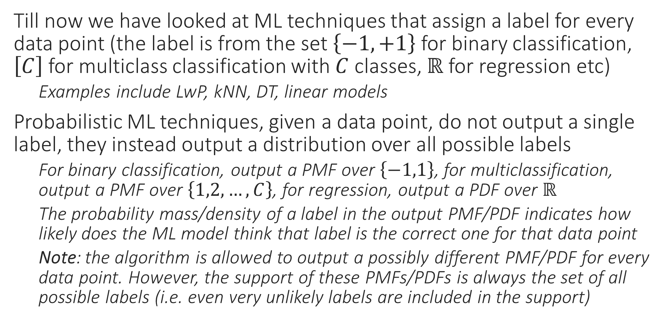
Probabilistic ML
Till now we have looked at ML techniques that assign a label for every data point (the label is from the set $\left\{−1,+1\right\}$ for binary classification, $\left[C\right]$ for multiclass classification with $C$ classes, $ℝ$ for regression etc)
Examples include LwP, kNN, DT, linear models
Probabilistic ML techniques, given a data point, do not output a single label, they instead output a distribution over all possible labels
For binary classification, output a PMF over $\left\{−1,1\right\}$, for multiclassification, output a PMF over $\left\{1,2,…,C\right\}$, for regression, output a PDF over $ℝ$
The probability mass/density of a label in the output PMF/PDF indicates how likely does the ML model think that label is the correct one for that data point
Note: the algorithm is allowed to output a possibly different PMF/PDF for every data point. However, the support of these PMFs/PDFs is always the set of all possible labels (i.e. even very unlikely labels are included in the support)

Slide 3


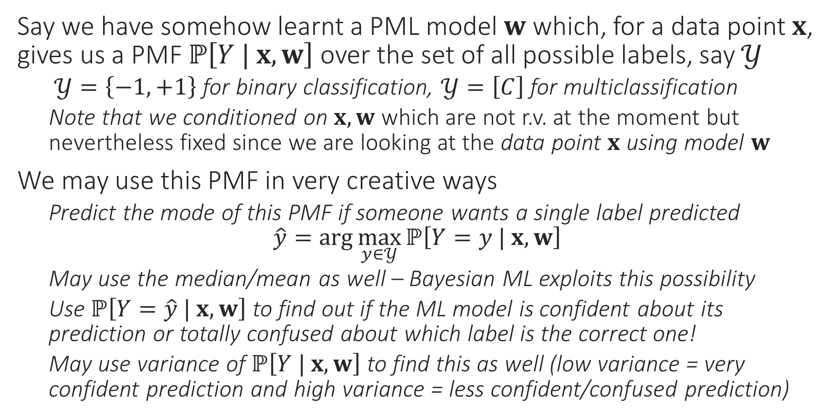
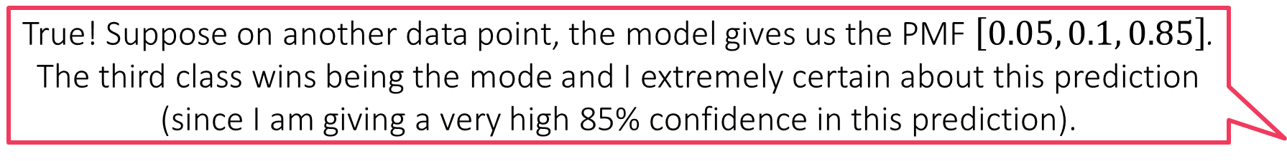
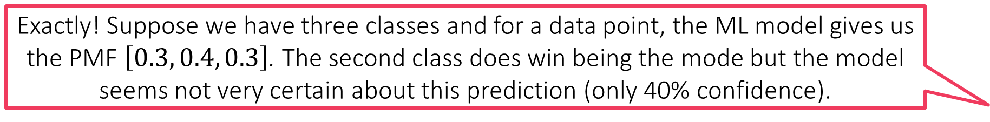
Probabilistic ML for Classification
Exactly! Suppose we have three classes and for a data point, the ML model gives us the PMF $\left[0.3, 0.4, 0.3\right]$. The second class does win being the mode but the model seems not very certain about this prediction (only 40% confidence).
Say we have somehow learnt a PML model $w$ which, for a data point $x$, gives us a PMF $ℙ\left[Y | x, w\right]$ over the set of all possible labels, say $𝒴$
$𝒴=\left\{−1,+1\right\}$ for binary classification, $𝒴=\left[C\right]$ for multiclassification
Note that we conditioned on $x, w$ which are not r.v. at the moment but nevertheless fixed since we are looking at the data point $x$ using model $w$
We may use this PMF in very creative ways
Predict the mode of this PMF if someone wants a single label predicted $\hat{y}=\arg{\max_{y∈𝒴}{ℙ\left[Y=y | x, w\right]}}$
May use the median/mean as well – Bayesian ML exploits this possibility
Use $ℙ\left[Y=\hat{y} | x, w\right]$ to find out if the ML model is confident about its prediction or totally confused about which label is the correct one!
May use variance of $ℙ\left[Y | x, w\right]$ to find this as well (low variance = very confident prediction and high variance = less confident/confused prediction)
True! Suppose on another data point, the model gives us the PMF $\left[0.05, 0.1, 0.85\right]$. The third class wins being the mode and I extremely certain about this prediction (since I am giving a very high 85% confidence in this prediction).
I could not agree more. However, in many ML applications (e.g. active learning) if we find that the model is making unsure predictions, we can switch to another model or just ask a human to step in. Thus, confidence info can be used fruitfully
Warning! Just because a prediction is made with more confidence does not mean it must be correct. It may happen that the 40% confidence prediction in the first case is correct but the high 85% confidence prediction in the second case is wrong!

Slide 4
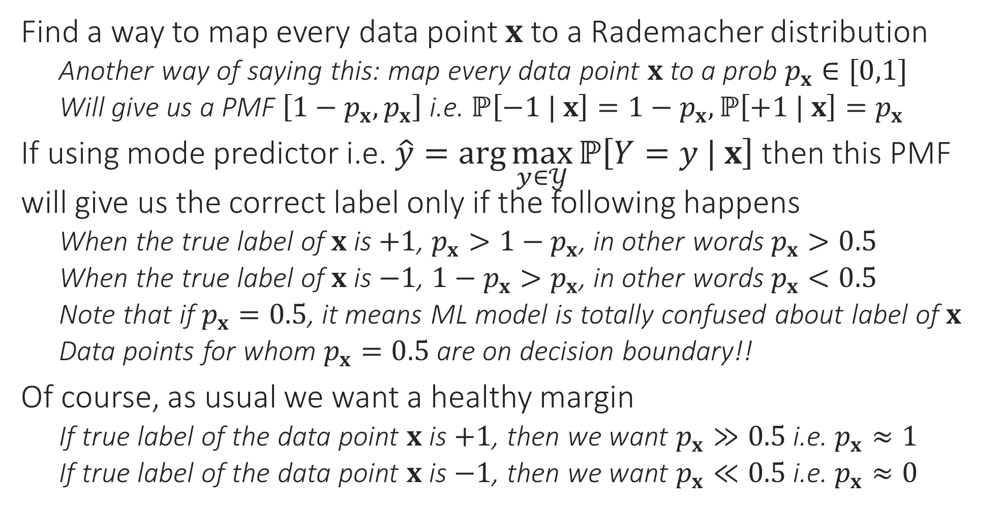
Probabilistic Binary Classification
Find a way to map every data point $x$ to a Rademacher distribution
Another way of saying this: map every data point $x$ to a prob $p_{x}∈[0,1]$
Will give us a PMF $\left[1−p_{x},p_{x}\right]$ i.e. $ℙ\left[−1 | x\right]=1−p_{x},ℙ\left[+1 | x\right]=p_{x}$
If using mode predictor i.e. $\hat{y}=\arg{\max_{y∈𝒴}{ℙ\left[Y=y | x\right]}}$ then this PMF will give us the correct label only if the following happens
When the true label of $x$ is $+1$, $p_{x}>1−p_{x}$, in other words $p_{x}>0.5$
When the true label of $x$ is $−1$, ${1−p}_{x}>p_{x}$, in other words $p_{x}<0.5$
Note that if $p_{x}=0.5$, it means ML model is totally confused about label of $x$
Data points for whom $p_{x}=0.5$ are on decision boundary!!
Of course, as usual we want a healthy margin
If true label of the data point $x$ is $+1$, then we want $p_{x}≫0.5$ i.e. $p_{x}≈1$
If true label of the data point $x$ is $−1$, then we want $p_{x}≪0.5$ i.e. $p_{x}≈0$

Slide 5

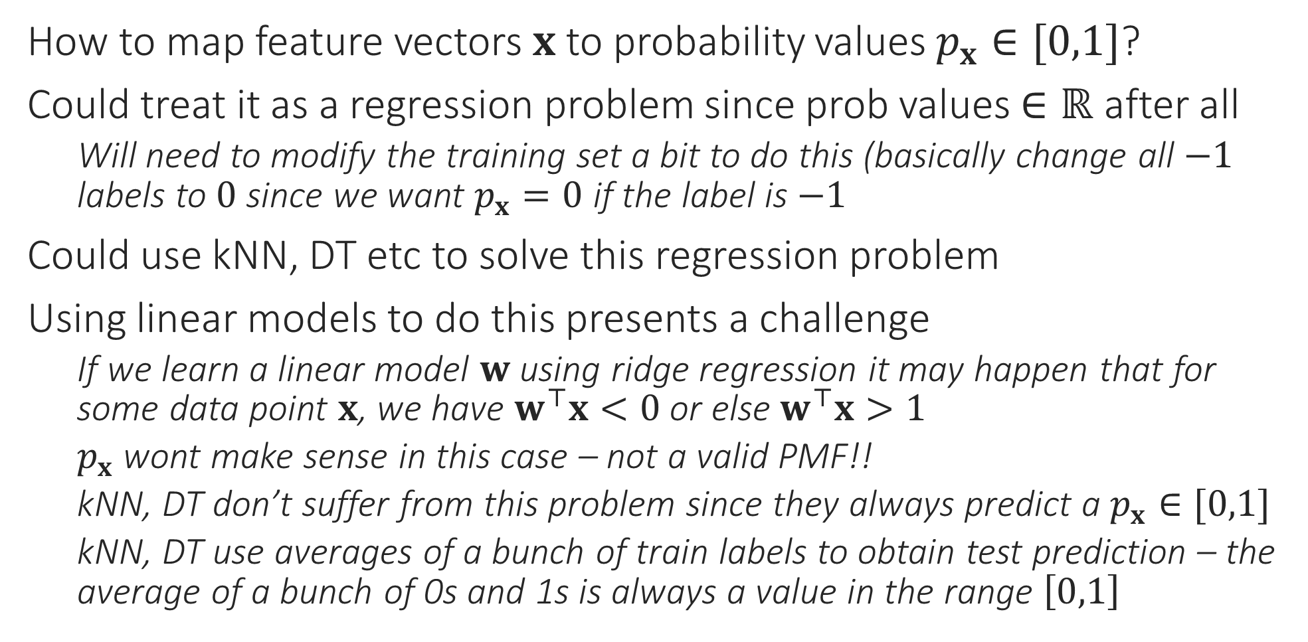
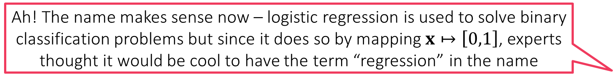
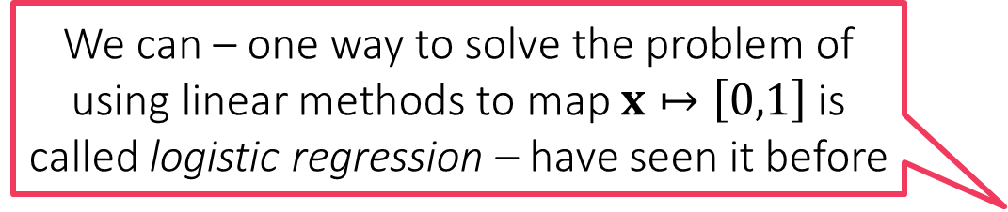
Probabilistic Binary Classification
So can we never use linear models to do probabilistic ML?
How to map feature vectors $x$ to probability values $p_{x}∈[0,1]$?
Could treat it as a regression problem since prob values $∈ℝ$ after all
Will need to modify the training set a bit to do this (basically change all $−1$ labels to $0$ since we want $p_{x}=0$ if the label is $−1$
Could use kNN, DT etc to solve this regression problem
Using linear models to do this presents a challenge
If we learn a linear model $w$ using ridge regression it may happen that for some data point $x$, we have $w^{⊤}x<0$ or else $w^{⊤}x>1$
$p_{x}$ wont make sense in this case – not a valid PMF!!
kNN, DT don’t suffer from this problem since they always predict a $p_{x}∈[0,1]$
kNN, DT use averages of a bunch of train labels to obtain test prediction – the average of a bunch of 0s and 1s is always a value in the range $\left[0,1\right]$
We can – one way to solve the problem of using linear methods to map $x↦\left[0,1\right]$ is called logistic regression – have seen it before
Yes, but there is a trick involved. Let us take a look at it
Ah! The name makes sense now – logistic regression is used to solve binary classification problems but since it does so by mapping $x↦\left[0,1\right]$, experts thought it would be cool to have the term “regression” in the name

Slide 6

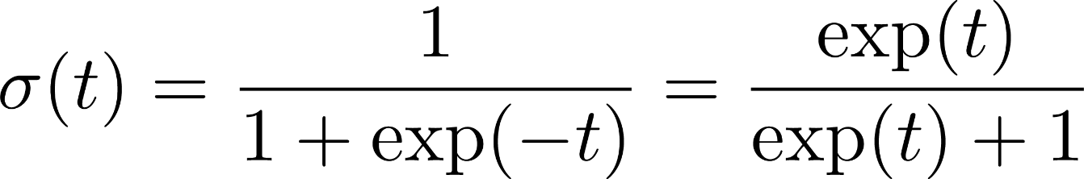
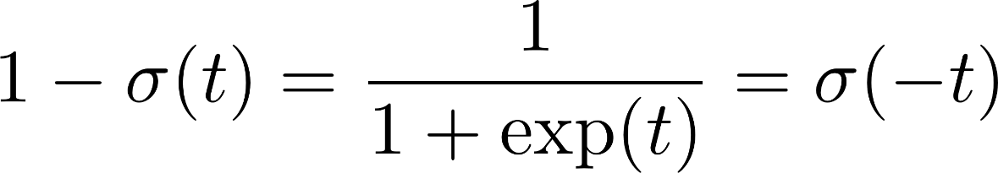
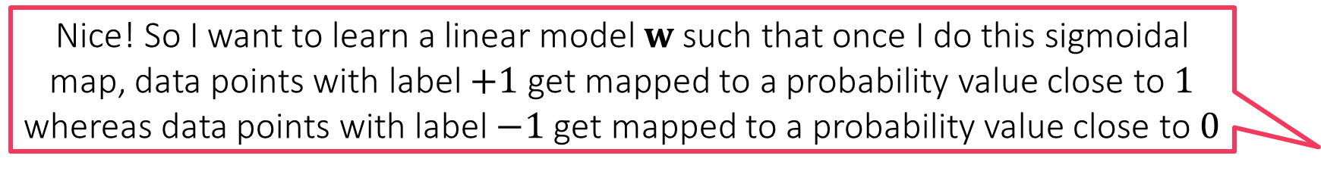
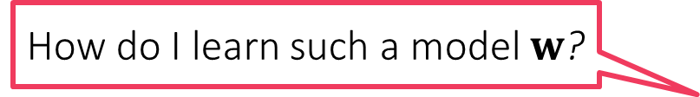
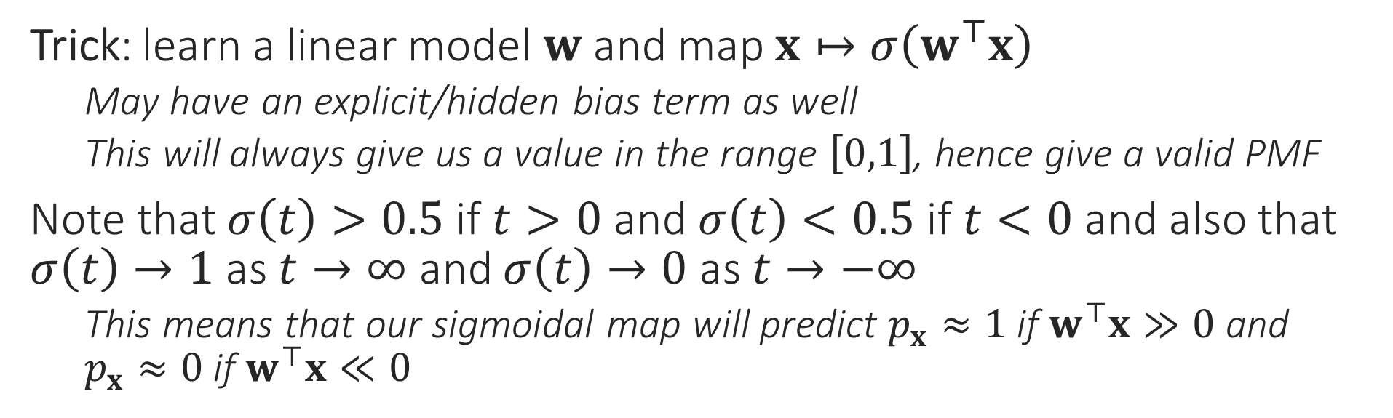
Sigmoid Function
Nice! So I want to learn a linear model $w$ such that once I do this sigmoidal map, data points with label $+1$ get mapped to a probability value close to $1$ whereas data points with label $−1$ get mapped to a probability value close to $0$
1
0.5
There are several other such wrapper/quashing/link/activation functions which do similar jobs e.g. tanh, ramp, ReLU
0
Trick: learn a linear model $w$ and map $x↦σ\left(w^{⊤}x\right)$
May have an explicit/hidden bias term as well
This will always give us a value in the range $\left[0,1\right]$, hence give a valid PMF
Note that $σ\left(t\right)>0.5$ if $t>0$ and $σ\left(t\right)<0.5$ if $t<0$ and also that $σ\left(t\right)→1$ as $t→∞$ and $σ\left(t\right)→0$ as $t→−∞$
This means that our sigmoidal map will predict $p_{x}≈1$ if $w^{⊤}x≫0$ and $p_{x}≈0$ if $w^{⊤}x≪0$
How do I learn such a model $w$?

Slide 7
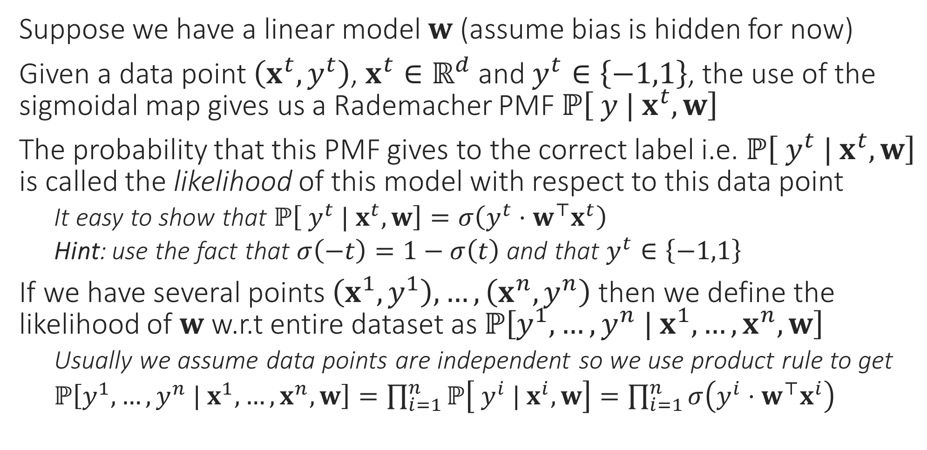
Likelihood
Data might not actually be independent e.g. my visiting a website may not be independent from my friend visiting the same website if I have found an offer on that website and posted about it on social website. However, often we nevertheless assume independence to make life simple
Suppose we have a linear model $w$ (assume bias is hidden for now)
Given a data point $\left(x^{t},y^{t}\right)$, $x^{t}∈ℝ^{d}$ and $y^{t}∈\left\{−1,1\right\}$, the use of the sigmoidal map gives us a Rademacher PMF $ℙ\left[ y | x^{t},w\right]$
The probability that this PMF gives to the correct label i.e. $ℙ\left[ y^{t} | x^{t},w\right]$ is called the likelihood of this model with respect to this data point
It easy to show that $ℙ\left[ y^{t} | x^{t},w\right]=σ\left(y^{t}⋅w^{⊤}x^{t}\right)$
Hint: use the fact that $σ\left(−t\right)=1−σ\left(t\right)$ and that $y^{t}∈\left\{−1,1\right\}$
If we have several points $\left(x^{1},y^{1}\right),…,\left(x^{n},y^{n}\right)$ then we define the likelihood of $w$ w.r.t entire dataset as $ℙ\left[y^{1},…,y^{n} | x^{1},…,x^{n},w\right]$
Usually we assume data points are independent so we use product rule to get
$ℙ\left[y^{1},…,y^{n} | x^{1},…,x^{n},w\right]=\prod_{i=1}^{n}{ℙ\left[ y^{i} | x^{i},w\right]}=\prod_{i=1}^{n}{σ\left(y^{i}⋅w^{⊤}x^{i}\right)}$

Slide 8
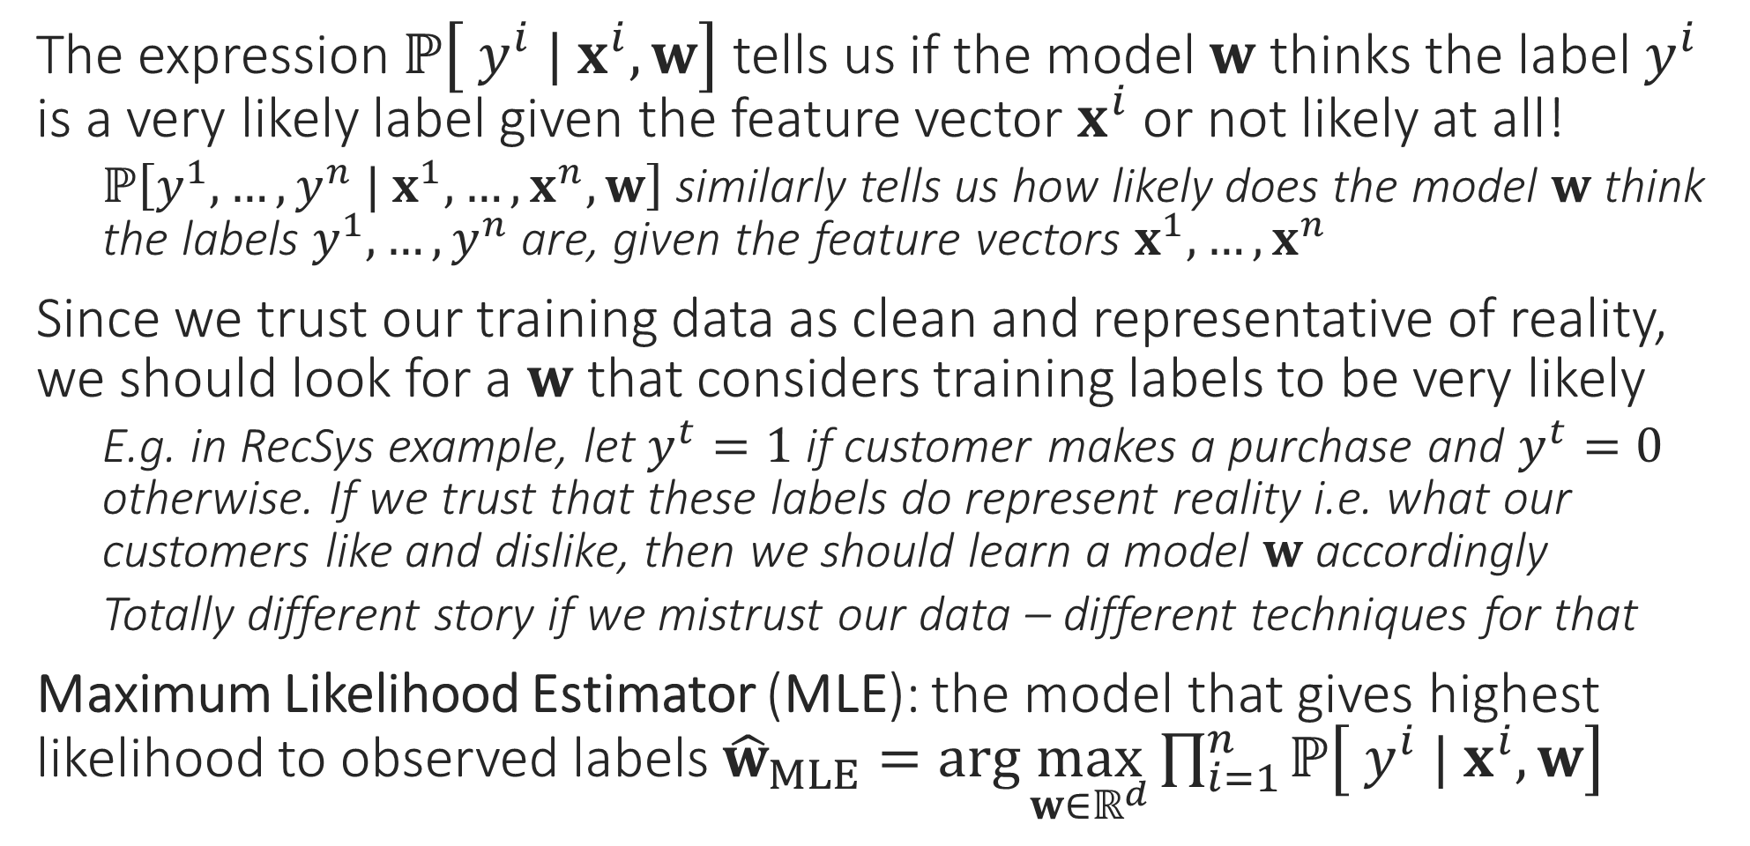
Maximum Likelihood
The expression $ℙ\left[ y^{i} | x^{i},w\right]$ tells us if the model $w$ thinks the label $y^{i}$ is a very likely label given the feature vector $x^{i}$ or not likely at all!
$ℙ\left[y^{1},…,y^{n} | x^{1},…,x^{n},w\right]$ similarly tells us how likely does the model $w$ think the labels $y^{1},…,y^{n}$ are, given the feature vectors $x^{1},…,x^{n}$
Since we trust our training data as clean and representative of reality, we should look for a $w$ that considers training labels to be very likely
E.g. in RecSys example, let $y^{t}=1$ if customer makes a purchase and $y^{t}=0$ otherwise. If we trust that these labels do represent reality i.e. what our customers like and dislike, then we should learn a model $w$ accordingly
Totally different story if we mistrust our data – different techniques for that
Maximum Likelihood Estimator (MLE): the model that gives highest likelihood to observed labels ${\hat{w}}_{MLE}=\arg{\max_{w∈ℝ^{d}}{\prod_{i=1}^{n}{ℙ\left[ y^{i} | x^{i},w\right]}}}$

Slide 9
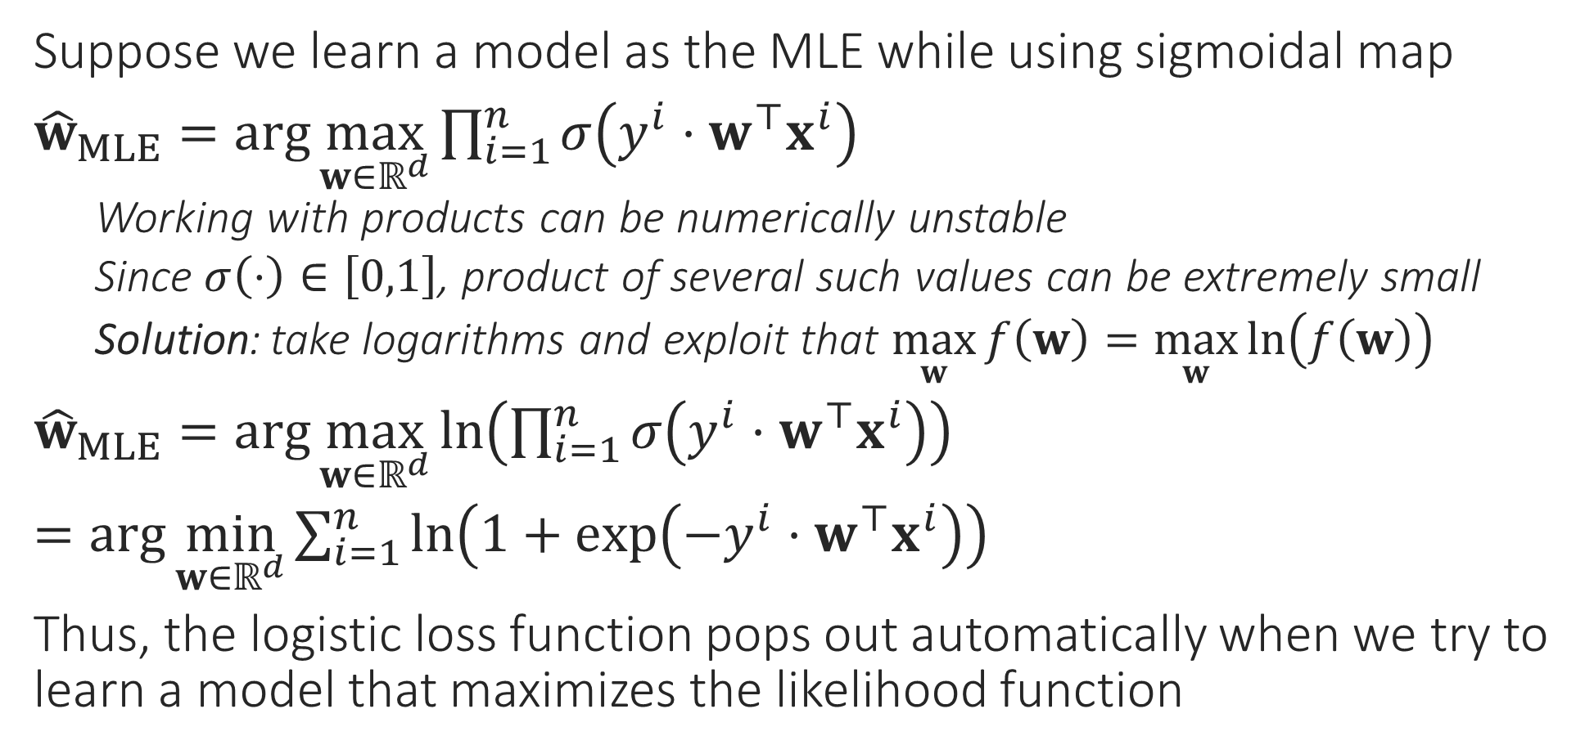
Logistic Regression
Suppose we learn a model as the MLE while using sigmoidal map
${\hat{w}}_{MLE}=\arg{\max_{w∈ℝ^{d}}{\prod_{i=1}^{n}{σ\left(y^{i}⋅w^{⊤}x^{i}\right)}}}$
Working with products can be numerically unstable
Since $σ\left(⋅\right)∈\left[0,1\right]$, product of several such values can be extremely small
Solution: take logarithms and exploit that $\max_{w}{f\left(w\right)}=\max_{w}{\ln\left(f\left(w\right)\right)}$
${\hat{w}}_{MLE}=\arg{\max_{w∈ℝ^{d}}{\ln\left(\prod_{i=1}^{n}{σ\left(y^{i}⋅w^{⊤}x^{i}\right)}\right)}}$
$=\arg{\min_{w∈ℝ^{d}}{\sum_{i=1}^{n}{\ln\left(1+\exp\left(−y^{i}⋅w^{⊤}x^{i}\right)\right)}}}$
Thus, the logistic loss function pops out automatically when we try to learn a model that maximizes the likelihood function
Also called negative log-likelihood

Slide 10


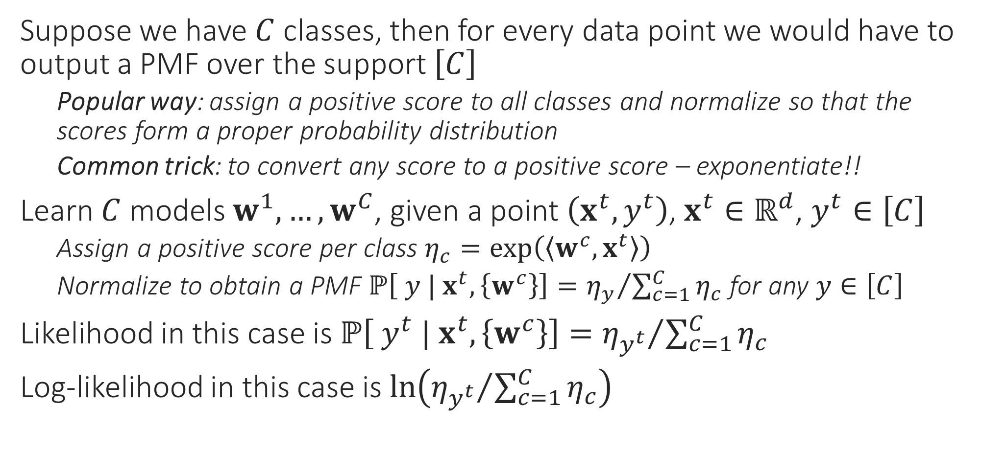
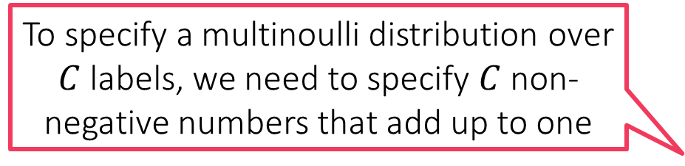
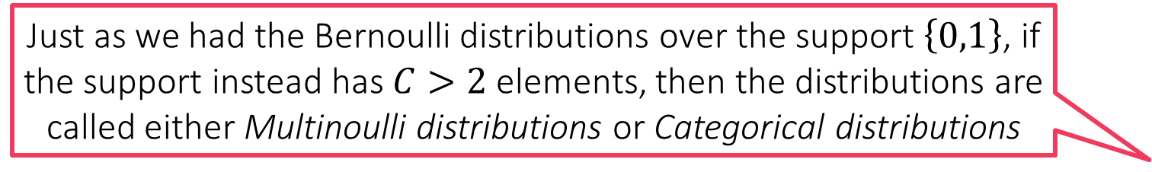
Probabilistic Multiclassification
Just as we had the Bernoulli distributions over the support $\left\{0,1\right\}$, if the support instead has $C>2$ elements, then the distributions are called either Multinoulli distributions or Categorical distributions
Suppose we have $C$ classes, then for every data point we would have to output a PMF over the support $\left[C\right]$
Popular way: assign a positive score to all classes and normalize so that the scores form a proper probability distribution
Common trick: to convert any score to a positive score – exponentiate!!
Learn $C$ models $w^{1},…,w^{C}$, given a point $\left(x^{t},y^{t}\right)$, $x^{t}∈ℝ^{d}$, $y^{t}∈\left[C\right]$
Assign a positive score per class $η_{c}=\exp\left(\left\langle w^{c},x^{t}\right\rangle \right)$
Normalize to obtain a PMF $ℙ\left[ y | x^{t},\left\{w^{c}\right\}\right]={η_{y}}/{\sum_{c=1}^{C}{η_{c}}}$ for any $y∈\left[C\right]$
Likelihood in this case is $ℙ\left[ y^{t} | x^{t},\left\{w^{c}\right\}\right]={η_{y^{t}}}/{\sum_{c=1}^{C}{η_{c}}}$
Log-likelihood in this case is $\ln\left({η_{y^{t}}}/{\sum_{c=1}^{C}{η_{c}}}\right)$
To specify a multinoulli distribution over $C$ labels, we need to specify $C$ non-negative numbers that add up to one

Slide 11


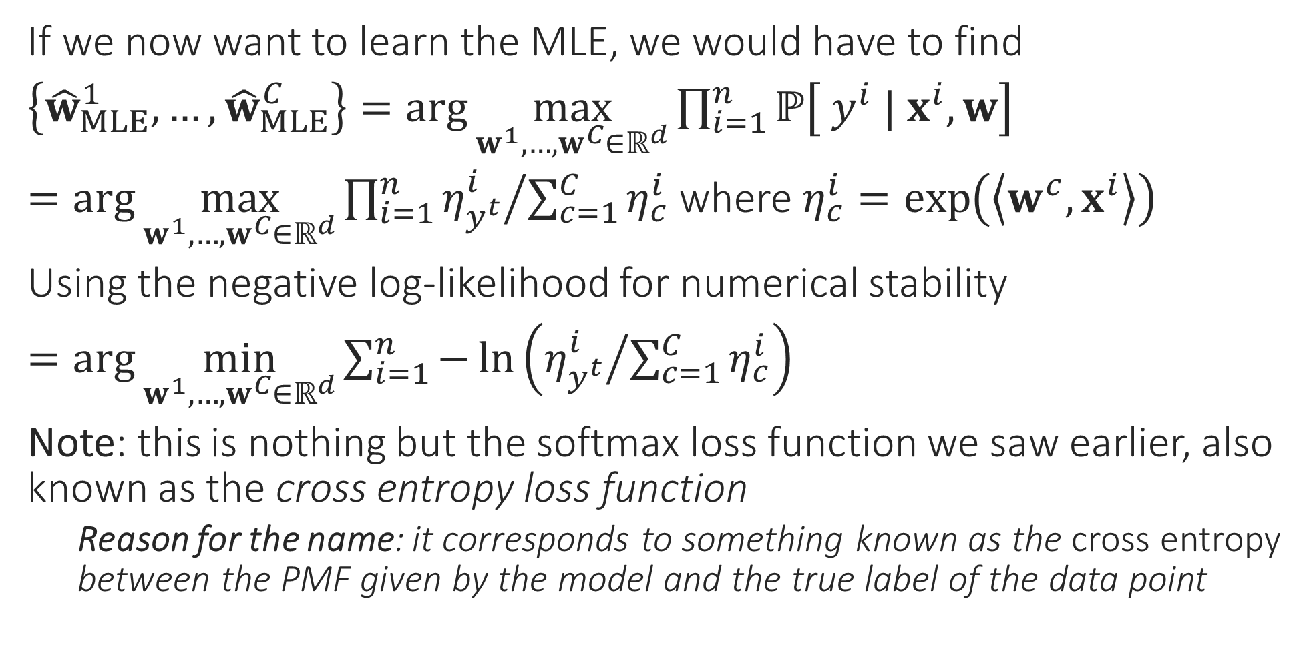
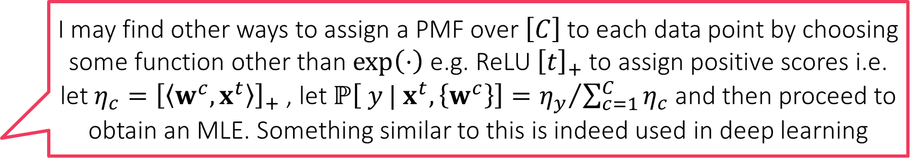
Softmax Regression
I may find other ways to assign a PMF over $\left[C\right]$ to each data point by choosing some function other than $\exp\left(⋅\right)$ e.g. ReLU ${\left[t\right]}_{+}$ to assign positive scores i.e. let $η_{c}={\left[\left\langle w^{c},x^{t}\right\rangle \right]}_{+}$ , let $ℙ\left[ y | x^{t},\left\{w^{c}\right\}\right]={η_{y}}/{\sum_{c=1}^{C}{η_{c}}}$ and then proceed to obtain an MLE. Something similar to this is indeed used in deep learning
If we now want to learn the MLE, we would have to find
$\left\{{\hat{w}}_{MLE}^{1},…,{\hat{w}}_{MLE}^{C}\right\}=\arg{\max_{w^{1},…,w^{C}∈ℝ^{d}}{\prod_{i=1}^{n}{ℙ\left[ y^{i} | x^{i},w\right]}}}$
$=\arg{\max_{w^{1},…,w^{C}∈ℝ^{d}}{\prod_{i=1}^{n}{{η_{y^{t}}^{i}}/{\sum_{c=1}^{C}{η_{c}^{i}}}}}}$ where $η_{c}^{i}=\exp\left(\left\langle w^{c},x^{i}\right\rangle \right)$
Using the negative log-likelihood for numerical stability
$=\arg{\min_{w^{1},…,w^{C}∈ℝ^{d}}{\sum_{i=1}^{n}{−\ln\left({η_{y^{t}}^{i}}/{\sum_{c=1}^{C}{η_{c}^{i}}}\right)}}}$
Note: this is nothing but the softmax loss function we saw earlier, also known as the cross entropy loss function
Reason for the name: it corresponds to something known as the cross entropy between the PMF given by the model and the true label of the data point
It should be noted that this is not the only way to do probabilistic multiclassification. It is just that this way is simple to understand, implement and hence popular
However, be warned that generating a PMF using DT/kNN need not necessarily be an MLE since we have not explicitly maximized any likelihood function here
I could do also kNN or DT and invoke the “probability as proportions” interpretation to assign a test data point to a PMF that simply gives the proportion of each label in the neighbourhood/leaf of that data point!!

Slide 12
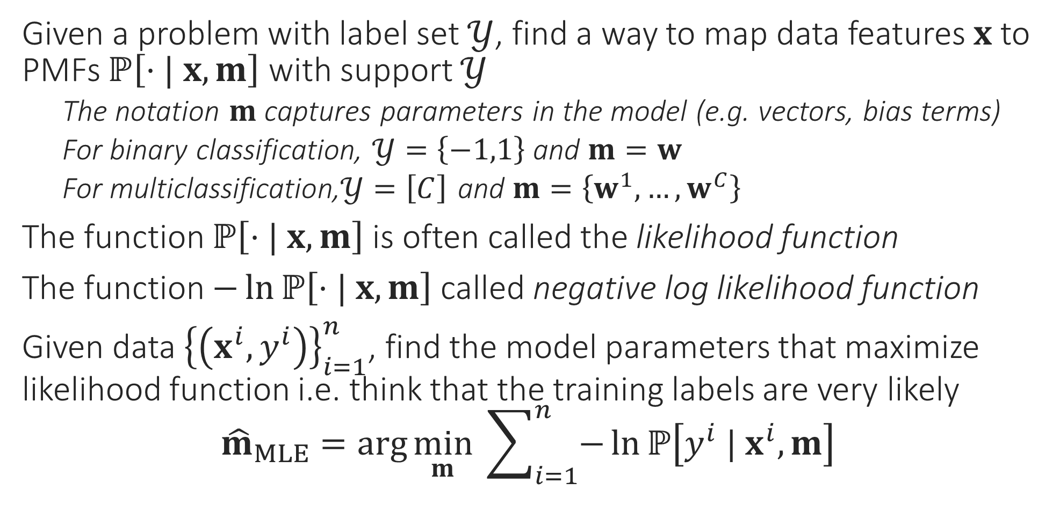
General Recipe for MLE Algorithms
Given a problem with label set $𝒴$, find a way to map data features $x$ to PMFs $ℙ\left[⋅| x, m\right]$ with support $𝒴$
The notation $m$ captures parameters in the model (e.g. vectors, bias terms)
For binary classification, $𝒴=\left\{−1,1\right\}$ and $m=w$
For multiclassification,$𝒴=\left[C\right]$ and $m=\left\{w^{1},…,w^{C}\right\}$
The function $ℙ\left[⋅| x, m\right]$ is often called the likelihood function
The function $−\ln{ℙ\left[⋅| x, m\right]}$ called negative log likelihood function
Given data ${\left\{\left(x^{i},y^{i}\right)\right\}}_{i=1}^{n}$, find the model parameters that maximize likelihood function i.e. think that the training labels are very likely ${\hat{m}}_{MLE}=\arg{\min_{m}{ \sum_{i=1}^{n}{−\ln{ℙ\left[y^{i} | x^{i}, m\right]}}}}$

Slide 13

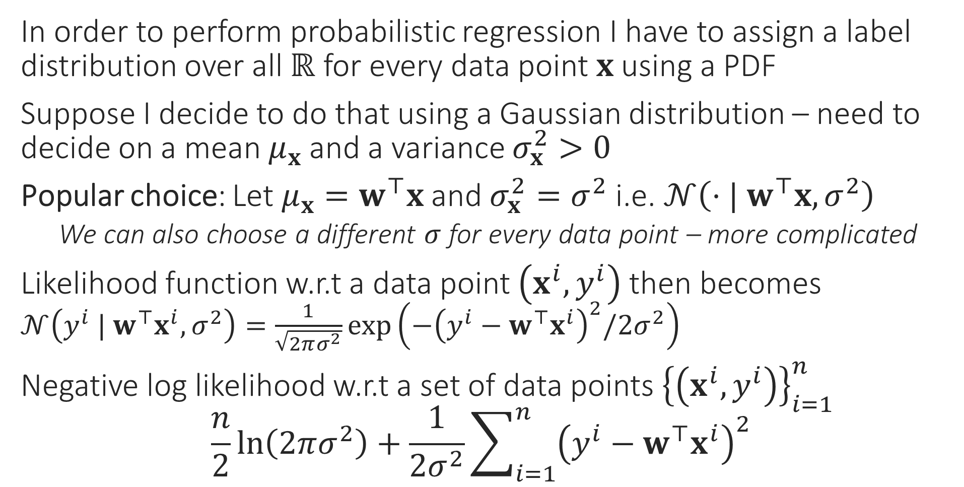
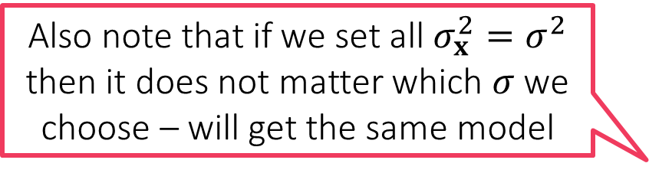
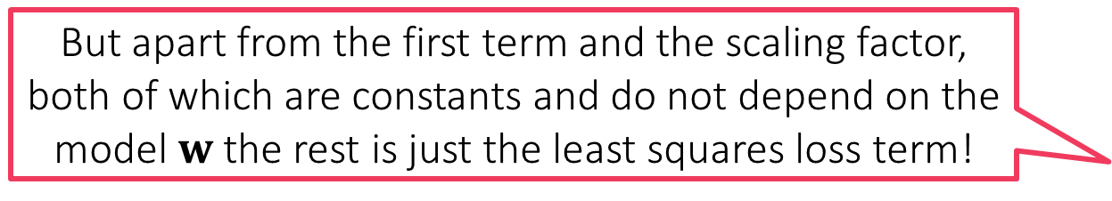
Probabilistic Regression
But apart from the first term and the scaling factor, both of which are constants and do not depend on the model $w$ the rest is just the least squares loss term!
In order to perform probabilistic regression I have to assign a label distribution over all $ℝ$ for every data point $x$ using a PDF
Suppose I decide to do that using a Gaussian distribution – need to decide on a mean $μ_{x}$ and a variance $σ_{x}^{2}>0$
Popular choice: Let $μ_{x}=w^{⊤}x$ and $σ_{x}^{2}=σ^{2}$ i.e. $𝒩\left(⋅| w^{⊤}x,σ^{2}\right)$
We can also choose a different $σ$ for every data point – more complicated
Likelihood function w.r.t a data point $\left(x^{i},y^{i}\right)$ then becomes $𝒩\left(y^{i} | w^{⊤}x^{i},σ^{2}\right)=\frac{1}{\sqrt{2πσ^{2}}}\exp\left(−{\left(y^{i}−w^{⊤}x^{i}\right)}^{2}/{2σ}^{2}\right)$
Negative log likelihood w.r.t a set of data points ${\left\{\left(x^{i},y^{i}\right)\right\}}_{i=1}^{n}$ $\frac{n}{2}ln\left(2πσ^{2}\right)+\frac{1}{2σ^{2}}\sum_{i=1}^{n}{{\left(y^{i}−w^{⊤}x^{i}\right)}^{2}}$
The MLE with respect to the Gaussian likelihood indeed the minimizes least squares loss
Also note that if we set all $σ_{x}^{2}=σ^{2}$ then it does not matter which $σ$ we choose – will get the same model
$$\min_{w∈ℝ^{d}}{}$$

Slide 14

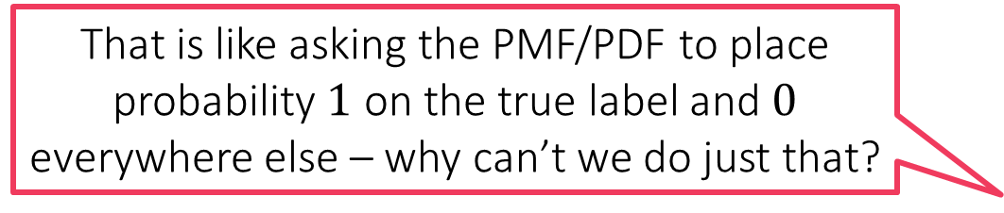
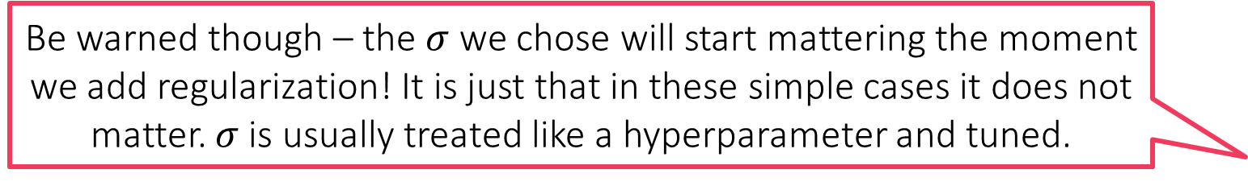
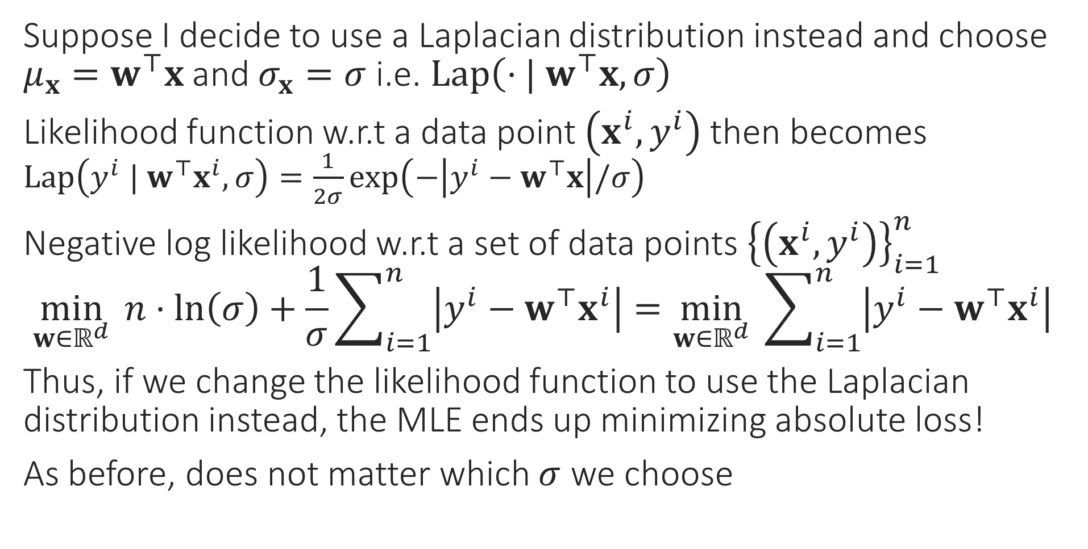
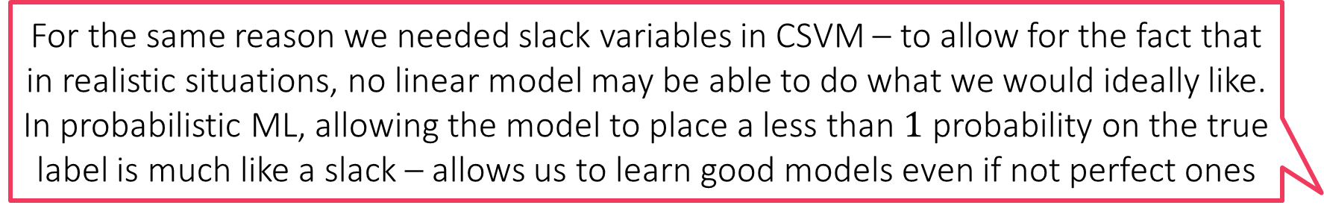
Probabilistic Regression
Be warned though – the $σ$ we chose will start mattering the moment we add regularization! It is just that in these simple cases it does not matter. $σ$ is usually treated like a hyperparameter and tuned.
Suppose I decide to use a Laplacian distribution instead and choose $μ_{x}=w^{⊤}x$ and $σ_{x}=σ$ i.e. $Lap\left(⋅| w^{⊤}x,σ\right)$
Likelihood function w.r.t a data point $\left(x^{i},y^{i}\right)$ then becomes $Lap\left(y^{i} | w^{⊤}x^{i},σ\right)=\frac{1}{2σ}\exp\left(−\left|y^{i}−w^{⊤}x\right|/σ\right)$
Negative log likelihood w.r.t a set of data points ${\left\{\left(x^{i},y^{i}\right)\right\}}_{i=1}^{n}$ $\min_{w∈ℝ^{d}}{ n⋅ln\left(σ\right)+\frac{1}{σ}\sum_{i=1}^{n}{\left|y^{i}−w^{⊤}x^{i}\right|}}=\min_{w∈ℝ^{d}}{ \sum_{i=1}^{n}{\left|y^{i}−w^{⊤}x^{i}\right|}}$
Thus, if we change the likelihood function to use the Laplacian distribution instead, the MLE ends up minimizing absolute loss!
As before, does not matter which $σ$ we choose
So I am a bit confused. All MLEs (classification/regression) demand a model that places maximum probability on the true label. Why don’t we just ask the model to predict the true label itself?
That is like asking the PMF/PDF to place probability $1$ on the true label and $0$ everywhere else – why can’t we do just that?
For the same reason we needed slack variables in CSVM – to allow for the fact that in realistic situations, no linear model may be able to do what we would ideally like. In probabilistic ML, allowing the model to place a less than $1$ probability on the true label is much like a slack – allows us to learn good models even if not perfect ones

Slide 15
Probabilistic Regularization??
We have seen that MLE often reduces to loss minimization e.g. logistic regression/least squares regression but without regularization terms ☹
Even probabilistic methods can do regularization by way of priors
Recall: regularization basically tells us which kinds of models we prefer
L2 regularization means we prefer models with small L2 norm
L1 regularization means we prefer models with small L1 norm/sparse models
In the language of probability, the most direct way of specifying such a preference is by specifying a probability distribution itself
Prior: a probability distribution over all possible models
Just like we usually decide regularization before seeing any data, prior distribution also does not consider/condition on, any data
But our models are vectors right? Can we have probability distribution over vectors as well?
Of course we can. But first, let us see the basic operations in a toy 1D setting before getting into the complications of vector-valued r.v.s

Slide 16
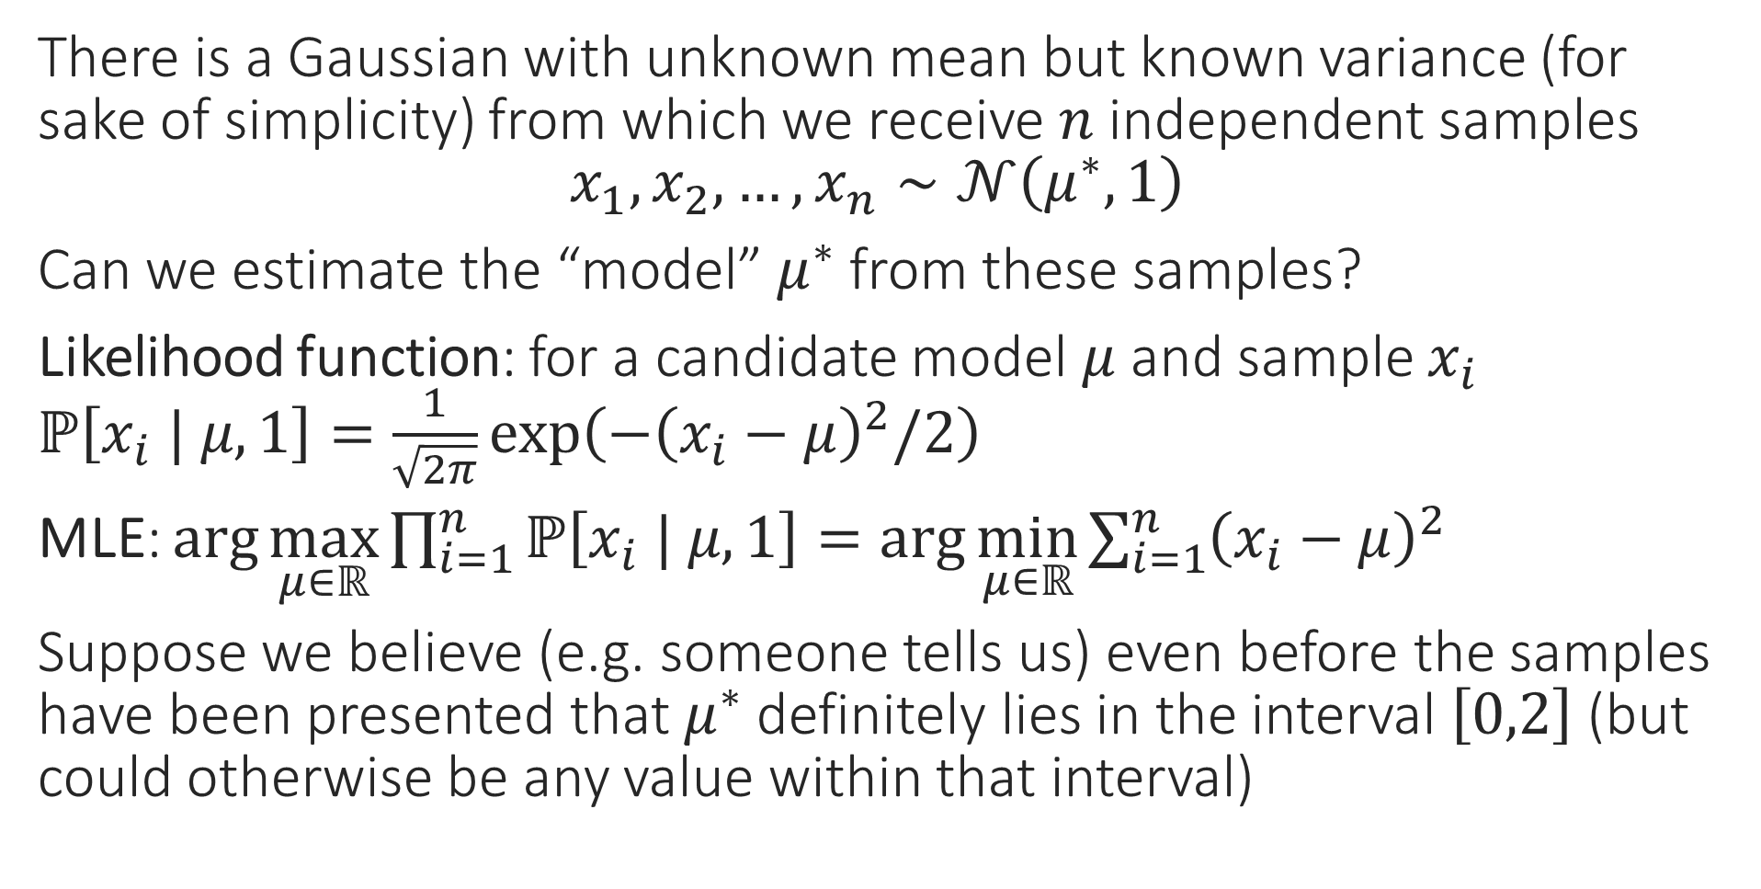
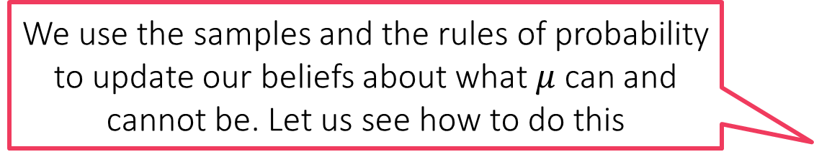
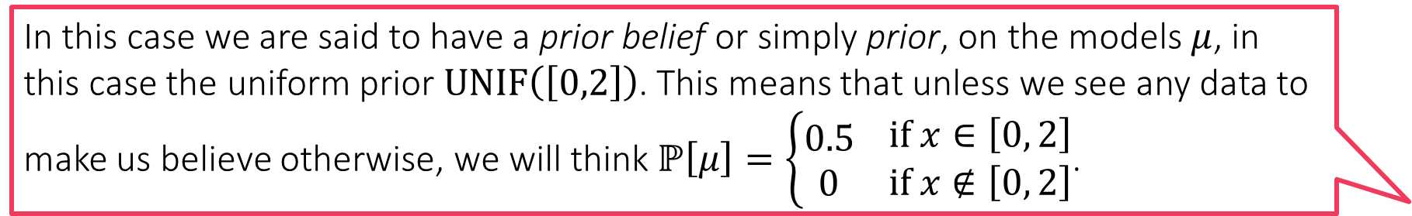
Can you Guess the Mean?
In this case we are said to have a prior belief or simply prior, on the models $μ$, in this case the uniform prior $UNIF\left(\left[0,2\right]\right)$. This means that unless we see any data to make us believe otherwise, we will think $ℙ\left[μ\right]=\left\{\begin{aligned}0.5 \\ 0\end{aligned} \begin{matrix}if x∈\left[0, 2\right] \\ if x∉\left[0, 2\right]\end{matrix}\right.$.
There is a Gaussian with unknown mean but known variance (for sake of simplicity) from which we receive $n$ independent samples $x_{1},x_{2},…,x_{n}∼𝒩\left(μ^{∗},1\right)$
Can we estimate the “model” $μ^{∗}$ from these samples?
Likelihood function: for a candidate model $μ$ and sample $x_{i}$ $ℙ\left[x_{i} | μ,1\right]=\frac{1}{\sqrt{2π}}\exp\left(−{\left(x_{i}−μ\right)}^{2}/2\right)$
MLE: $\arg{\max_{μ∈ℝ}{\prod_{i=1}^{n}{ℙ\left[x_{i} | μ,1\right]}}}=\arg{\min_{μ∈ℝ}{\sum_{i=1}^{n}{{\left(x_{i}−μ\right)}^{2}}}}$
Suppose we believe (e.g. someone tells us) even before the samples have been presented that $μ^{∗}$ definitely lies in the interval $\left[0,2\right]$ (but could otherwise be any value within that interval)
What happens we do see some data, namely the actual samples from the distribution?
We use the samples and the rules of probability to update our beliefs about what $μ$ can and cannot be. Let us see how to do this

Slide 17
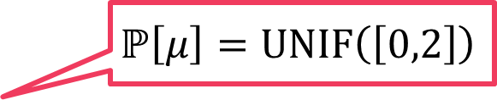
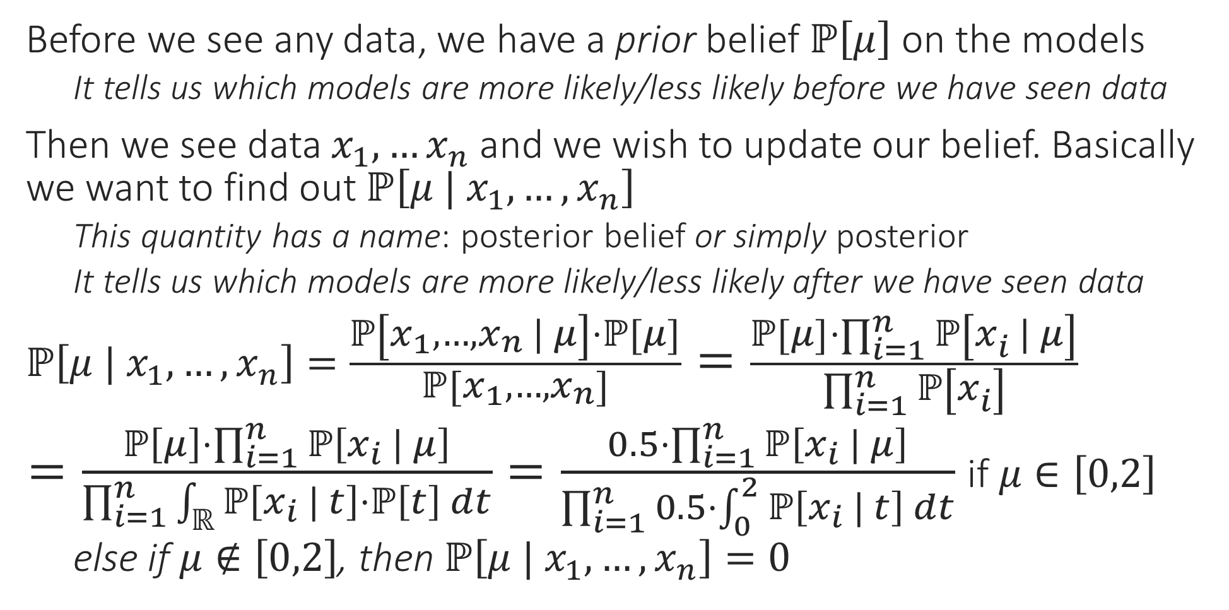
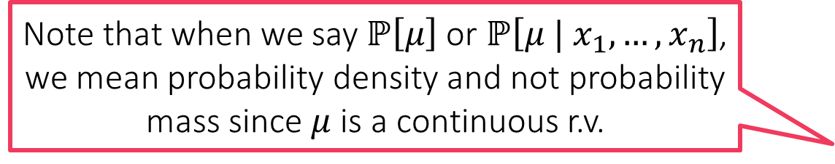
Posterior
Before we see any data, we have a prior belief $ℙ\left[μ\right]$ on the models
It tells us which models are more likely/less likely before we have seen data
Then we see data $x_{1},…x_{n}$ and we wish to update our belief. Basically we want to find out $ℙ\left[μ | x_{1},…,x_{n}\right]$
This quantity has a name: posterior belief or simply posterior
It tells us which models are more likely/less likely after we have seen data
$ℙ\left[μ | x_{1},…,x_{n}\right]=\frac{ℙ\left[x_{1},…,x_{n} | μ\right]⋅ℙ\left[μ\right]}{ℙ\left[x_{1},…,x_{n}\right]}=\frac{ℙ\left[μ\right]⋅\prod_{i=1}^{n}{ℙ\left[x_{i} | μ\right]}}{\prod_{i=1}^{n}{ℙ\left[x_{i}\right]}}$
$=\frac{ℙ\left[μ\right]⋅\prod_{i=1}^{n}{ℙ\left[x_{i} | μ\right]}}{\prod_{i=1}^{n}{\int_{ℝ}{ℙ\left[x_{i} | t\right]⋅ℙ\left[t\right] dt}}}=\frac{0.5⋅\prod_{i=1}^{n}{ℙ\left[x_{i} | μ\right]}}{\prod_{i=1}^{n}{0.5⋅\int_{0}^{2}{ℙ\left[x_{i} | t\right] dt}}}$ if $μ∈\left[0,2\right]$
else if $μ∉\left[0,2\right]$, then $ℙ\left[μ | x_{1},…,x_{n}\right]=0$
Note that when we say $ℙ\left[μ\right]$ or $ℙ\left[μ | x_{1},…,x_{n}\right]$, we mean probability density and not probability mass since $μ$ is a continuous r.v.
Bayes Rule
Samples are independent
Law of total probability
$$ℙ\left[μ\right]=UNIF\left(\left[0,2\right]\right)$$

Slide 18


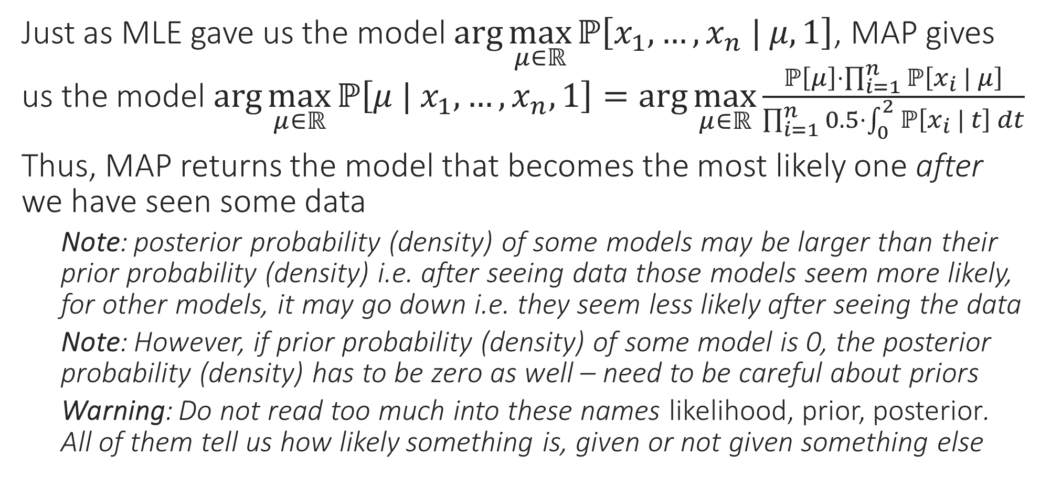
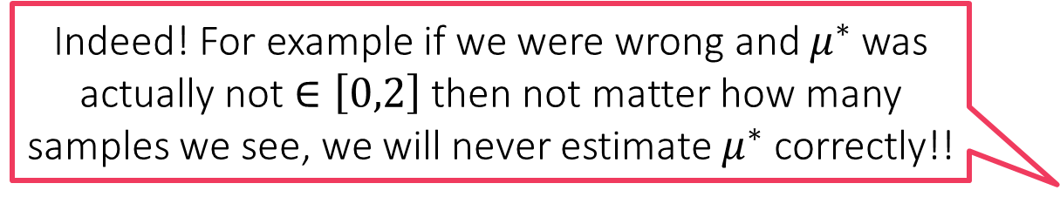
Maximum a Posteriori (MAP) Estimate
It is better to choose priors that do not completely exclude some models by giving them 0 probability (as we did)
Just as MLE gave us the model $\arg{\max_{μ∈ℝ}{ℙ\left[x_{1},…,x_{n} | μ,1\right]}}$, MAP gives us the model $\arg{\max_{μ∈ℝ}{ℙ\left[μ | x_{1},…,x_{n},1\right]}}=\arg{\max_{μ∈ℝ}}\frac{ℙ\left[μ\right]⋅\prod_{i=1}^{n}{ℙ\left[x_{i} | μ\right]}}{\prod_{i=1}^{n}{0.5⋅\int_{0}^{2}{ℙ\left[x_{i} | t\right] dt}}}$
Thus, MAP returns the model that becomes the most likely one after we have seen some data
Note: posterior probability (density) of some models may be larger than their prior probability (density) i.e. after seeing data those models seem more likely, for other models, it may go down i.e. they seem less likely after seeing the data
Note: However, if prior probability (density) of some model is 0, the posterior probability (density) has to be zero as well – need to be careful about priors
Warning: Do not read too much into these names likelihood, prior, posterior. All of them tell us how likely something is, given or not given something else
True! Even in general, if your priors are bad, or too strong, then you may end up getting funny models as a result of doing MAP estimation
Indeed! For example if we were wrong and $μ^{∗}$ was actually not $∈\left[0,2\right]$ then not matter how many samples we see, we will never estimate $μ^{∗}$ correctly!!

Slide 19
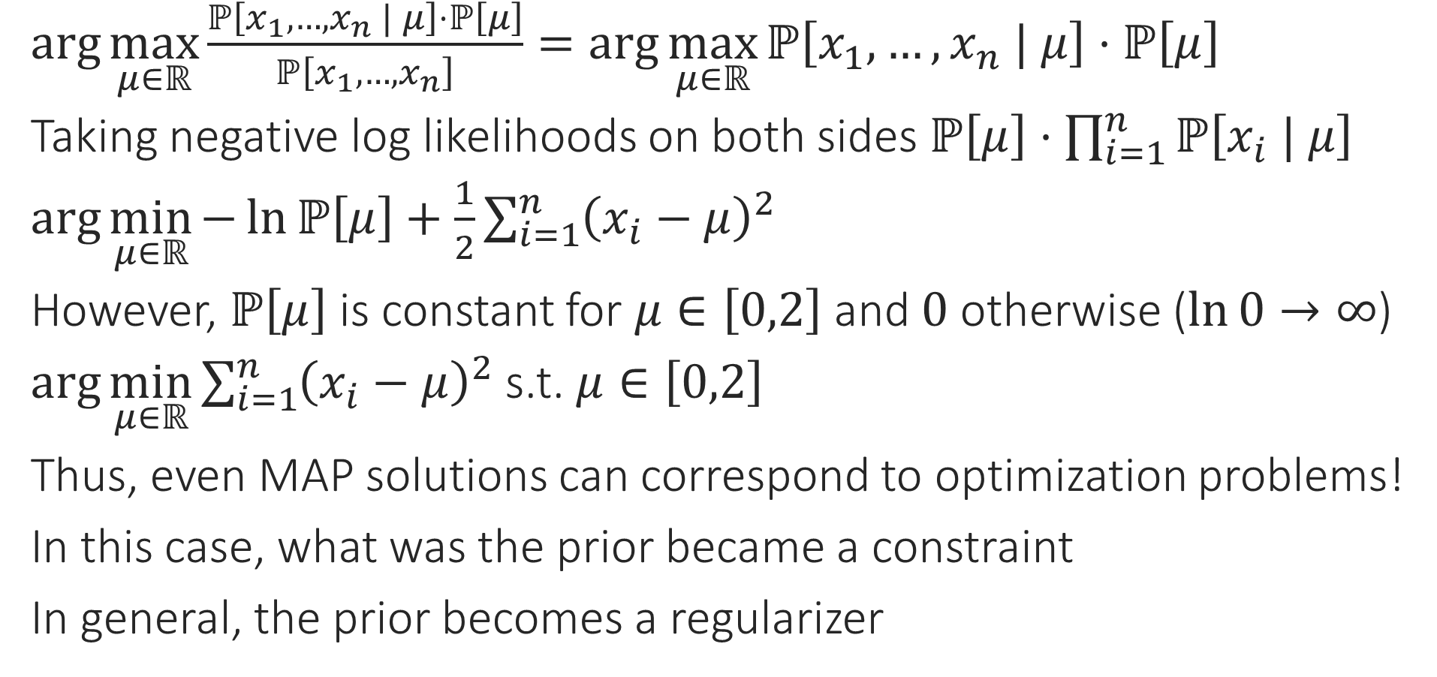
MAP vs Regularization
$\arg{\max_{μ∈ℝ}{\frac{ℙ\left[x_{1},…,x_{n} | μ\right]⋅ℙ\left[μ\right]}{ℙ\left[x_{1},…,x_{n}\right]}}}=\arg{\max_{μ∈ℝ}{ℙ\left[x_{1},…,x_{n} | μ\right]⋅ℙ\left[μ\right]}}$
Taking negative log likelihoods on both sides $ℙ\left[μ\right]⋅\prod_{i=1}^{n}{ℙ\left[x_{i} | μ\right]}$
$\arg{\min_{μ∈ℝ}{−\ln{ℙ\left[μ\right]}+\frac{1}{2}\sum_{i=1}^{n}{{\left(x_{i}−μ\right)}^{2}}}}$
However, $ℙ\left[μ\right]$ is constant for $μ∈\left[0,2\right]$ and $0$ otherwise ($\ln{0}→∞$)
$\arg{\min_{μ∈ℝ}{\sum_{i=1}^{n}{{\left(x_{i}−μ\right)}^{2}}}}$ s.t. $μ∈\left[0,2\right]$
Thus, even MAP solutions can correspond to optimization problems!
In this case, what was the prior became a constraint
In general, the prior becomes a regularizer

Slide 20

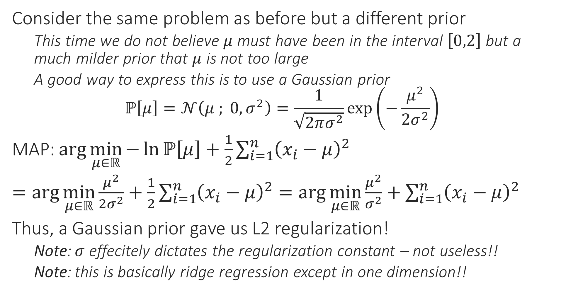
MAP vs Regularization
Similarly, had we used a Laplacian prior, we would have obtained L1 regularization instead
Consider the same problem as before but a different prior
This time we do not believe $μ$ must have been in the interval $\left[0,2\right]$ but a much milder prior that $μ$ is not too large
A good way to express this is to use a Gaussian prior $ℙ\left[μ\right]=𝒩\left(μ ; 0,σ^{2}\right)=\frac{1}{\sqrt{2πσ^{2}}}\exp\left(−\frac{μ^{2}}{2σ^{2}}\right)$
MAP: $\arg{\min_{μ∈ℝ}{−\ln{ℙ\left[μ\right]}+\frac{1}{2}\sum_{i=1}^{n}{{\left(x_{i}−μ\right)}^{2}}}}$
$=\arg{\min_{μ∈ℝ}{\frac{μ^{2}}{{2σ}^{2}}+\frac{1}{2}\sum_{i=1}^{n}{{\left(x_{i}−μ\right)}^{2}}}}=\arg{\min_{μ∈ℝ}{\frac{μ^{2}}{σ^{2}}+\sum_{i=1}^{n}{{\left(x_{i}−μ\right)}^{2}}}}$
Thus, a Gaussian prior gave us L2 regularization!
Note: $σ$ effecitely dictates the regularization constant – not useless!!
Note: this is basically ridge regression except in one dimension!!
The regularization constant is dictated by the strength of the regularization. Be careful not to have strong priors (uninformed strong opinions are bad in real life too ☺)

Slide 21
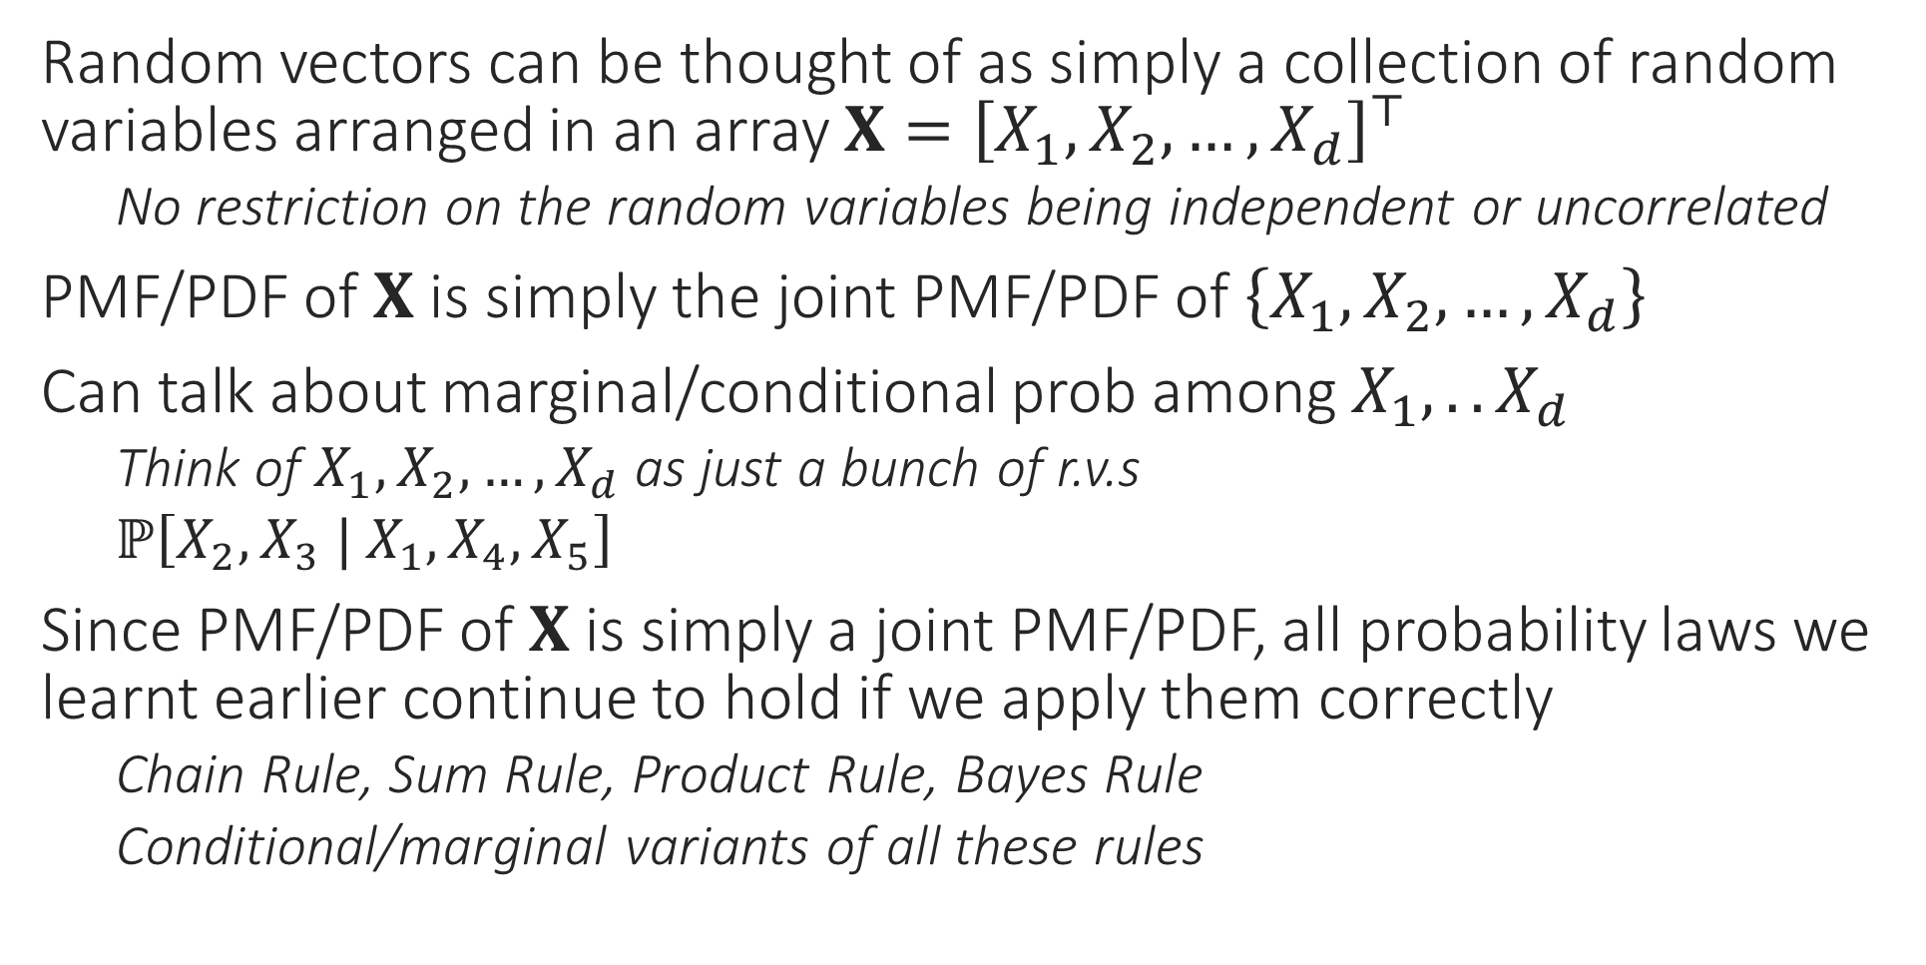
Random Vectors
Random vectors can be thought of as simply a collection of random variables arranged in an array $X={\left[X_{1},X_{2},…,X_{d}\right]}^{⊤}$
No restriction on the random variables being independent or uncorrelated
PMF/PDF of $X$ is simply the joint PMF/PDF of $\left\{X_{1},X_{2},…,X_{d}\right\}$
Can talk about marginal/conditional prob among $X_{1},.. X_{d}$
Think of $X_{1},X_{2},…,X_{d}$ as just a bunch of r.v.s
$ℙ\left[X_{2},X_{3} | X_{1},X_{4},X_{5}\right]$
Since PMF/PDF of $X$ is simply a joint PMF/PDF, all probability laws we learnt earlier continue to hold if we apply them correctly
Chain Rule, Sum Rule, Product Rule, Bayes Rule
Conditional/marginal variants of all these rules

Slide 22
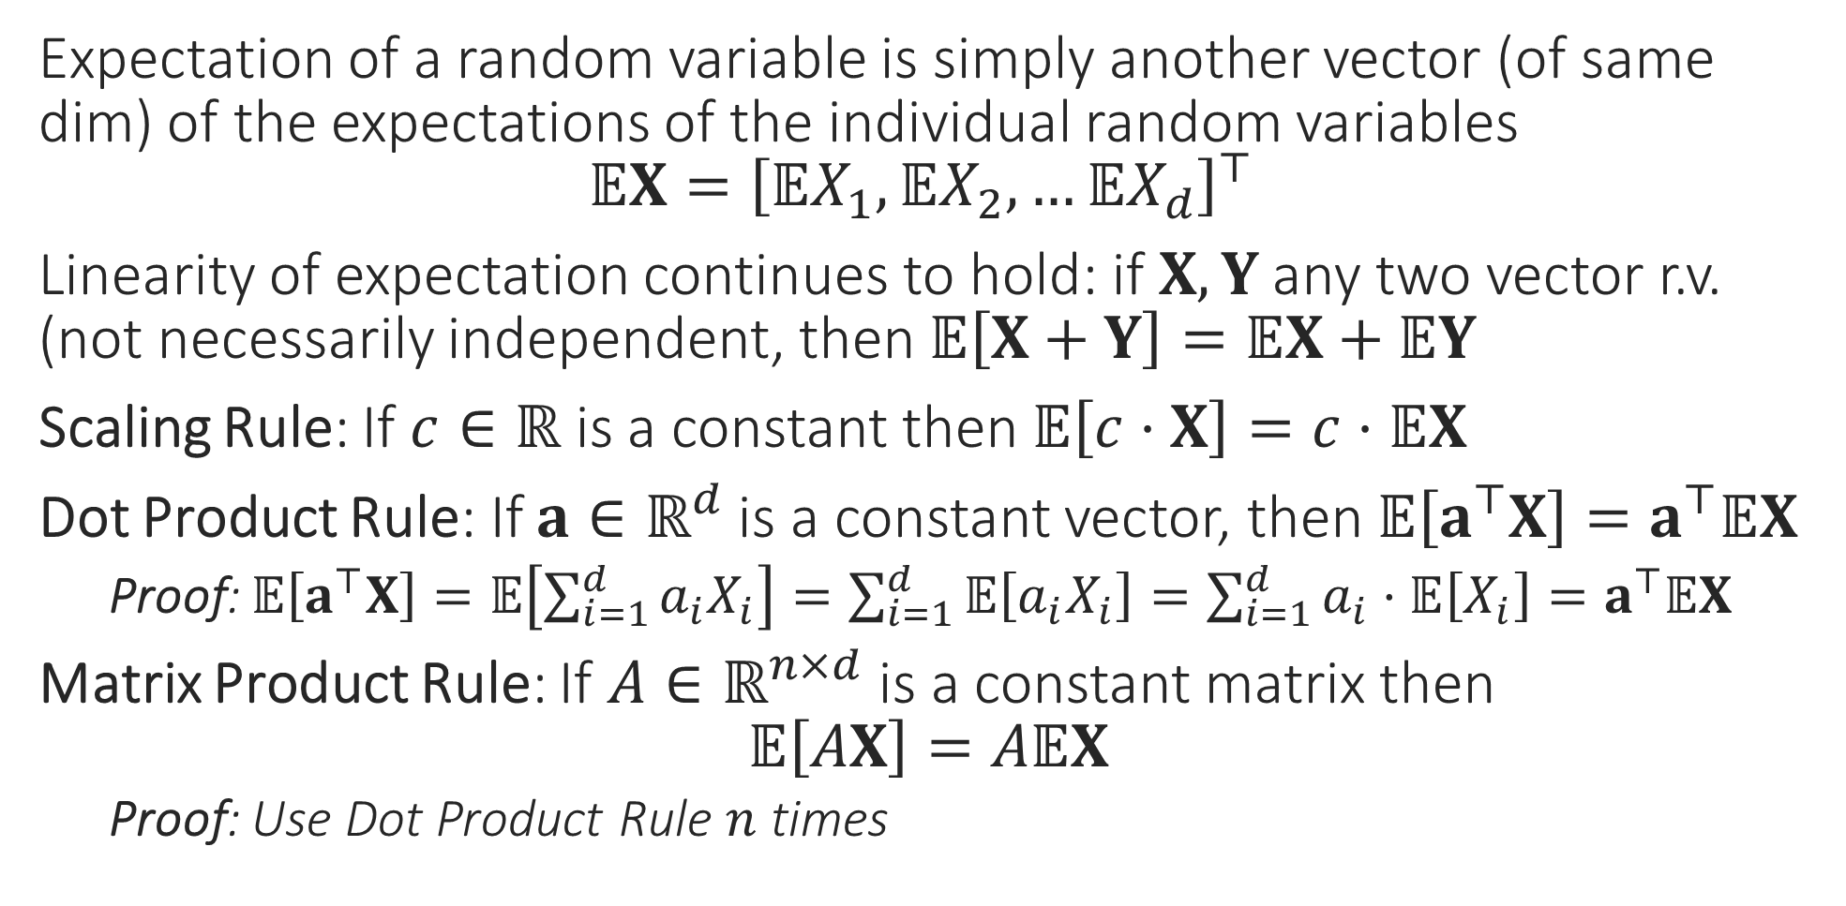
Random Vectors
Expectation of a random variable is simply another vector (of same dim) of the expectations of the individual random variables $𝔼X={\left[𝔼X_{1},𝔼X_{2},…𝔼X_{d}\right]}^{⊤}$
Linearity of expectation continues to hold: if $X,Y$ any two vector r.v. (not necessarily independent, then $𝔼\left[X+Y\right]=𝔼X+𝔼Y$
Scaling Rule: If $c∈ℝ$ is a constant then $𝔼\left[c⋅X\right]=c⋅𝔼X$
Dot Product Rule: If $a∈ℝ^{d}$ is a constant vector, then $𝔼\left[a^{⊤}X\right]=a^{⊤}𝔼X$
Proof: $𝔼\left[a^{⊤}X\right]=𝔼\left[\sum_{i=1}^{d}{a_{i}X_{i}}\right]=\sum_{i=1}^{d}{𝔼\left[a_{i}X_{i}\right]}=\sum_{i=1}^{d}{a_{i}⋅𝔼\left[X_{i}\right]}=a^{⊤}𝔼X$
Matrix Product Rule: If $A∈ℝ^{n×d}$ is a constant matrix then $𝔼\left[AX\right]=A𝔼X$
Proof: Use Dot Product Rule $n$ times

Slide 23
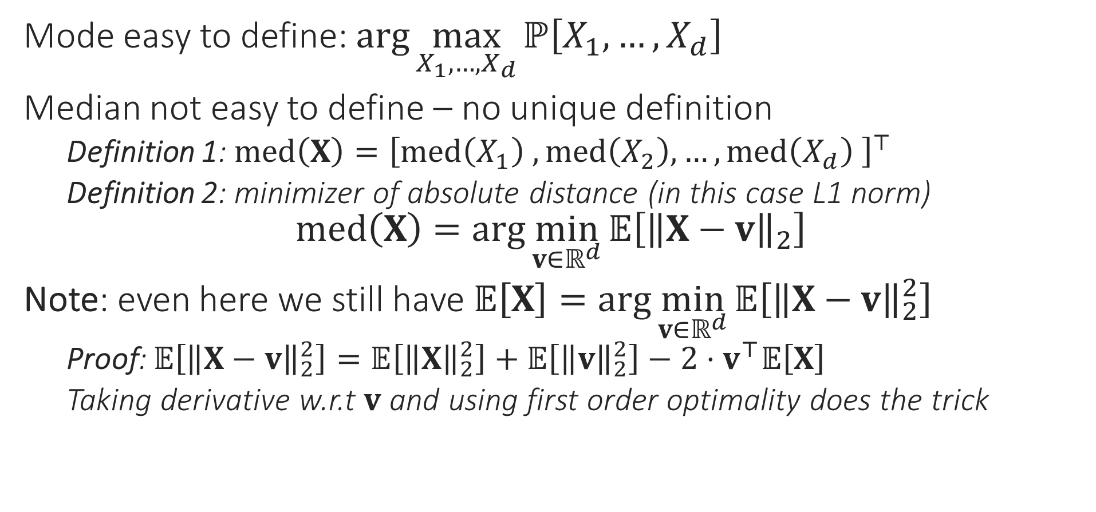
Random Vectors
Mode easy to define: $\arg{\max_{X_{1},…,X_{d}}{ℙ\left[X_{1},…,X_{d}\right]}}$
Median not easy to define – no unique definition
Definition 1: $med\left(X\right)={\left[med\left(X_{1}\right) ,med\left(X_{2}\right),…,med\left(X_{d}\right) \right]}^{⊤}$
Definition 2: minimizer of absolute distance (in this case L1 norm) $med\left(X\right)=\arg{\min_{v∈ℝ^{d}}{𝔼\left[{\left\|X−v\right\|}_{2}\right]}}$
Note: even here we still have $𝔼\left[X\right]=\arg{\min_{v∈ℝ^{d}}{𝔼\left[{\left\|X−v\right\|}_{2}^{2}\right]}}$
Proof: $𝔼\left[{\left\|X−v\right\|}_{2}^{2}\right]=𝔼\left[{\left\|X\right\|}_{2}^{2}\right]+𝔼\left[{\left\|v\right\|}_{2}^{2}\right]−2⋅v^{⊤}𝔼\left[X\right]$
Taking derivative w.r.t $v$ and using first order optimality does the trick

Slide 24
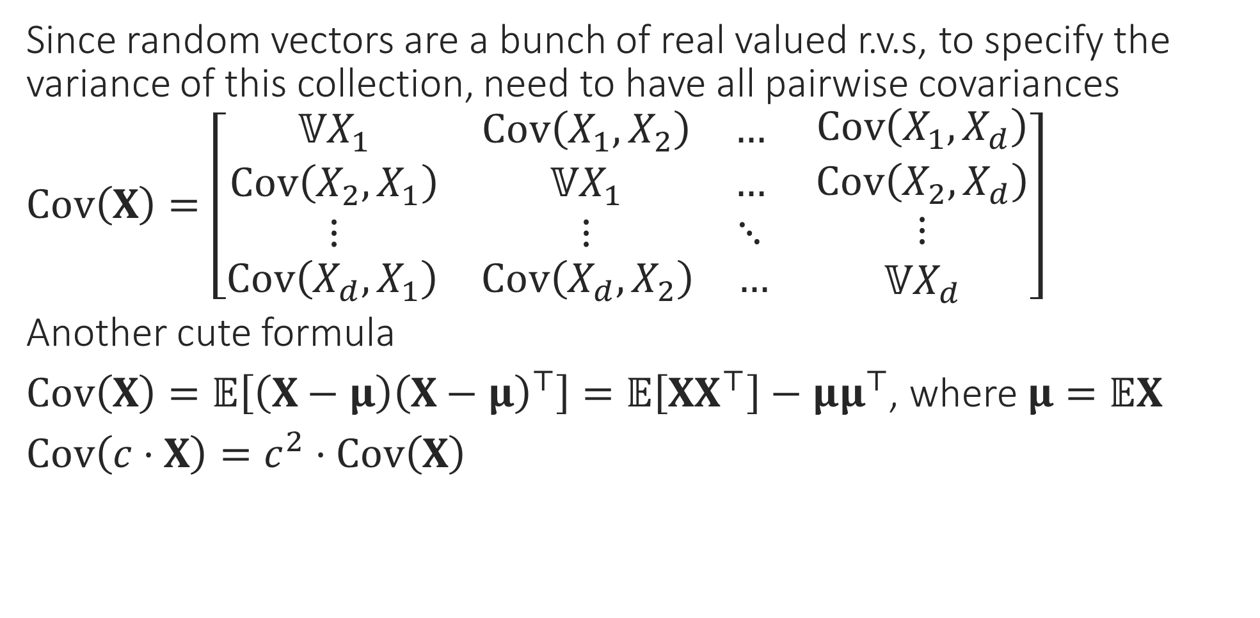
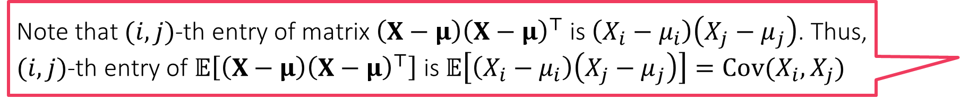
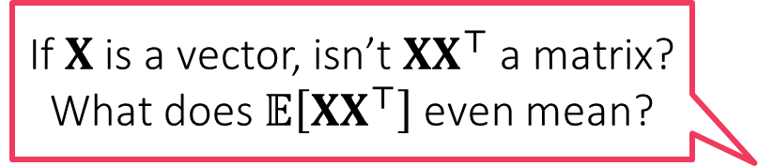
Random Vectors
If $X$ is a vector, isn’t $XX^{⊤}$ a matrix? What does $𝔼\left[XX^{⊤}\right]$ even mean?
Since random vectors are a bunch of real valued r.v.s, to specify the variance of this collection, need to have all pairwise covariances
$Cov\left(X\right)=\left[\begin{aligned}\begin{matrix}𝕍X_{1} & Cov\left(X_{1},X_{2}\right) & … \\ Cov\left(X_{2},X_{1}\right) & 𝕍X_{1} & … \\ ⋮ & ⋮ & ⋱\end{matrix} \\ \begin{matrix}Cov\left(X_{d},X_{1}\right) & Cov\left(X_{d},X_{2}\right) & …\end{matrix}\end{aligned} \begin{matrix}Cov\left(X_{1},X_{d}\right) \\ Cov\left(X_{2},X_{d}\right) \\ \begin{aligned}⋮ \\ 𝕍X_{d}\end{aligned}\end{matrix}\right]$
Another cute formula
$Cov\left(X\right)=𝔼\left[\left(X−μ\right){\left(X−μ\right)}^{⊤}\right]=𝔼\left[XX^{⊤}\right]−μμ^{⊤}$, where $μ=𝔼X$
$Cov\left(c⋅X\right)=c^{2}⋅Cov\left(X\right)$
Just as a random vector is a collection of random variables arranged as a 1D array, a random matrix is a collection of r.v.s arranged as a 2D array!
Note that $(i,j)$-th entry of matrix $\left(X−μ\right){\left(X−μ\right)}^{⊤}$ is $\left(X_{i}−μ_{i}\right)\left(X_{j}−μ_{j}\right)$. Thus, $(i,j)$-th entry of $𝔼\left[\left(X−μ\right){\left(X−μ\right)}^{⊤}\right]$ is $𝔼\left[\left(X_{i}−μ_{i}\right)\left(X_{j}−μ_{j}\right)\right]=Cov(X_{i},X_{j})$

Slide 25
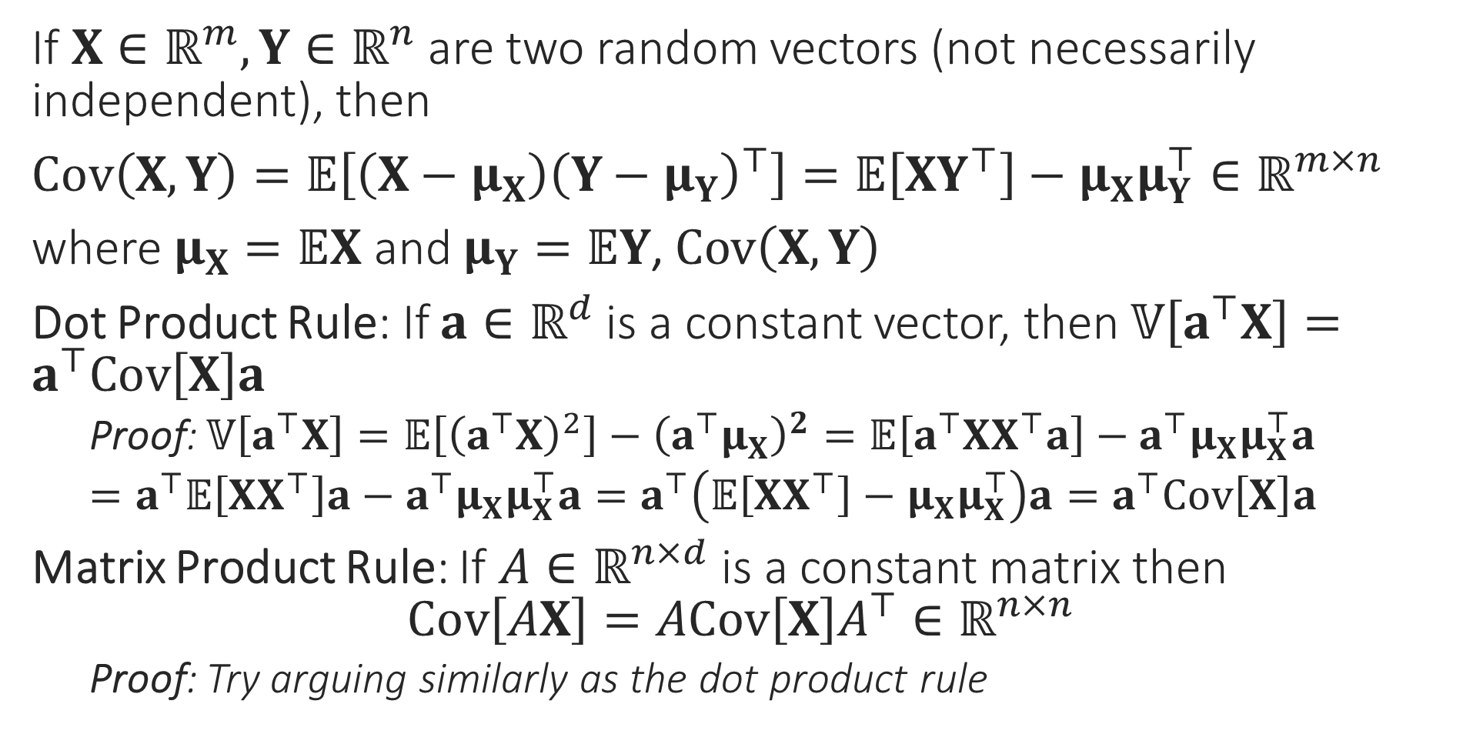
Useful Operations on Vector R.V.
Can you prove that the covariance matrix of any random vector is always a PSD matrix?
If $X∈ℝ^{m},Y∈ℝ^{n}$ are two random vectors (not necessarily independent), then
$Cov\left(X,Y\right)=𝔼\left[\left(X−μ_{X}\right){\left(Y−μ_{Y}\right)}^{⊤}\right]=𝔼\left[XY^{⊤}\right]−μ_{X}μ_{Y}^{⊤}∈ℝ^{m×n}$
where $μ_{X}=𝔼X$ and $μ_{Y}=𝔼Y$, $Cov\left(X,Y\right)$
Dot Product Rule: If $a∈ℝ^{d}$ is a constant vector, then $𝕍\left[a^{⊤}X\right]=a^{⊤}Cov\left[X\right]a$
Proof: $𝕍\left[a^{⊤}X\right]=𝔼\left[{\left(a^{⊤}X\right)}^{2}\right]−{\left(a^{⊤}μ_{X}\right)}^{2}=𝔼\left[a^{⊤}XX^{⊤}a\right]−a^{⊤}μ_{X}μ_{X}^{⊤}a$
$=a^{⊤}𝔼\left[XX^{⊤}\right]a−a^{⊤}μ_{X}μ_{X}^{⊤}a=a^{⊤}\left(𝔼\left[XX^{⊤}\right]−μ_{X}μ_{X}^{⊤}\right)a=a^{⊤}Cov\left[X\right]a$
Matrix Product Rule: If $A∈ℝ^{n×d}$ is a constant matrix then $Cov\left[AX\right]=ACov\left[X\right]A^{⊤}∈ℝ^{n×n}$
Proof: Try arguing similarly as the dot product rule

Slide 26
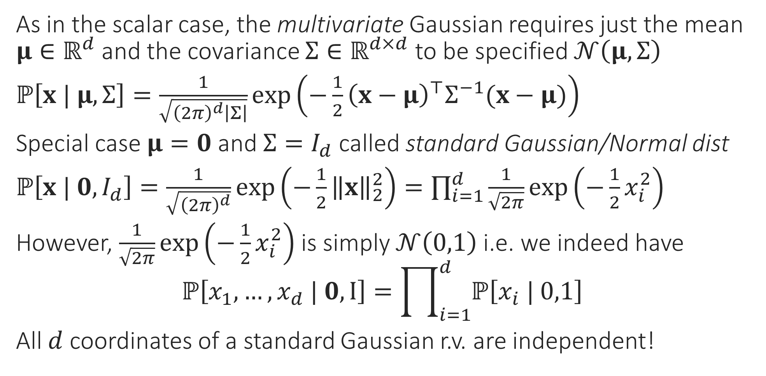
Gaussian Random Vector
As in the scalar case, the multivariate Gaussian requires just the mean $μ∈ℝ^{d}$ and the covariance $Σ∈ℝ^{d×d}$ to be specified $𝒩\left(μ,Σ\right)$
$ℙ\left[x | μ,Σ\right]=\frac{1}{\sqrt{{\left(2π\right)}^{d}\left|Σ\right|}}\exp\left(−\frac{1}{2}{\left(x−μ\right)}^{⊤}Σ^{−1}(x−μ)\right)$
Special case $μ=0$ and $Σ=I_{d}$ called standard Gaussian/Normal dist
$ℙ\left[x | 0,I_{d}\right]=\frac{1}{\sqrt{{\left(2π\right)}^{d}}}\exp\left(−\frac{1}{2}{\left\|x\right\|}_{2}^{2}\right)=\prod_{i=1}^{d}{\frac{1}{\sqrt{2π}}\exp\left(−\frac{1}{2}x_{i}^{2}\right)}$
However, $\frac{1}{\sqrt{2π}}\exp\left(−\frac{1}{2}x_{i}^{2}\right)$ is simply $𝒩\left(0,1\right)$ i.e. we indeed have $ℙ\left[x_{1},…,x_{d} | 0,I\right]=\prod_{i=1}^{d}{ℙ\left[x_{i} | 0,1\right]}$
All $d$ coordinates of a standard Gaussian r.v. are independent!

Slide 27
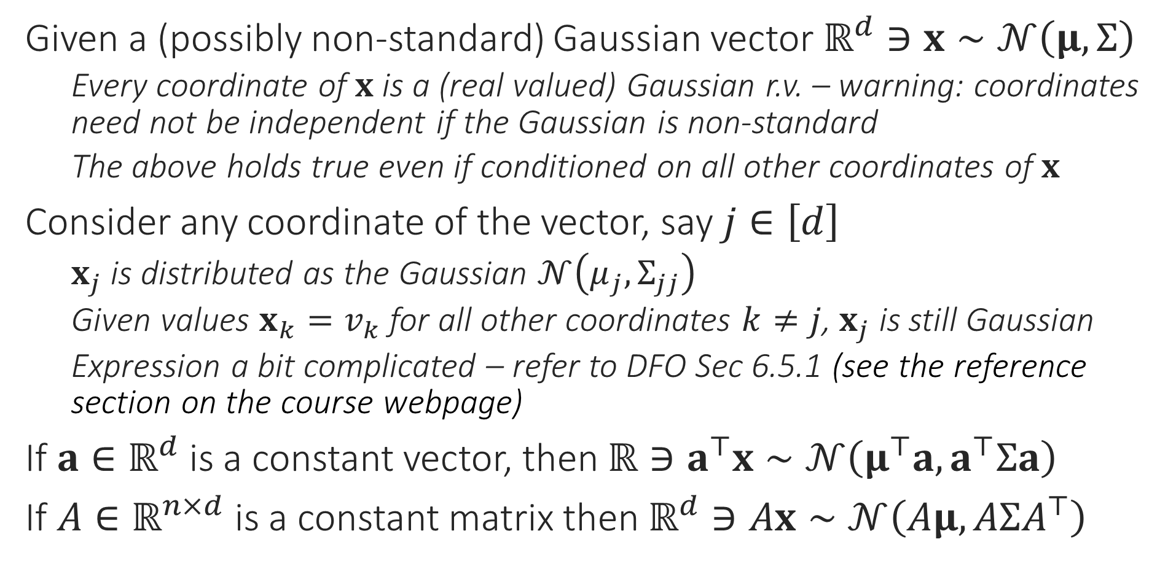
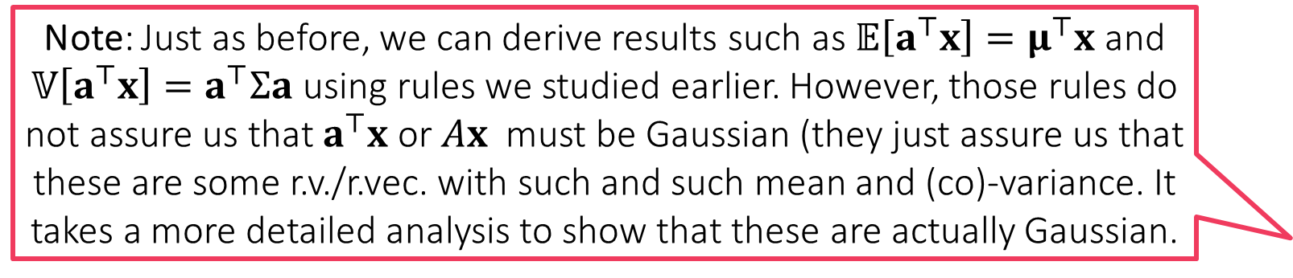
Gaussian Random Vector
Note: Just as before, we can derive results such as $𝔼\left[a^{⊤}x\right]=μ^{⊤}x$ and $𝕍\left[a^{⊤}x\right]=a^{⊤}Σa$ using rules we studied earlier. However, those rules do not assure us that $a^{⊤}x$ or $Ax$ must be Gaussian (they just assure us that these are some r.v./r.vec. with such and such mean and (co)-variance. It takes a more detailed analysis to show that these are actually Gaussian.
Given a (possibly non-standard) Gaussian vector $ℝ^{d}∋x∼𝒩\left(μ,Σ\right)$
Every coordinate of $x$ is a (real valued) Gaussian r.v. – warning: coordinates need not be independent if the Gaussian is non-standard
The above holds true even if conditioned on all other coordinates of $x$
Consider any coordinate of the vector, say $j∈\left[d\right]$
$x_{j}$ is distributed as the Gaussian $𝒩\left(μ_{j},Σ_{jj}\right)$
Given values ${x_{k}=v}_{k}$ for all other coordinates $k≠j$, $x_{j}$ is still Gaussian
Expression a bit complicated – refer to DFO Sec 6.5.1 (see the reference section on the course webpage)
If $a∈ℝ^{d}$ is a constant vector, then $ℝ∋a^{⊤}x∼𝒩\left(μ^{⊤}a,a^{⊤}Σa\right)$
If $A∈ℝ^{n×d}$ is a constant matrix then $ℝ^{d}∋Ax∼𝒩\left(Aμ,AΣA^{⊤}\right)$

Slide 28
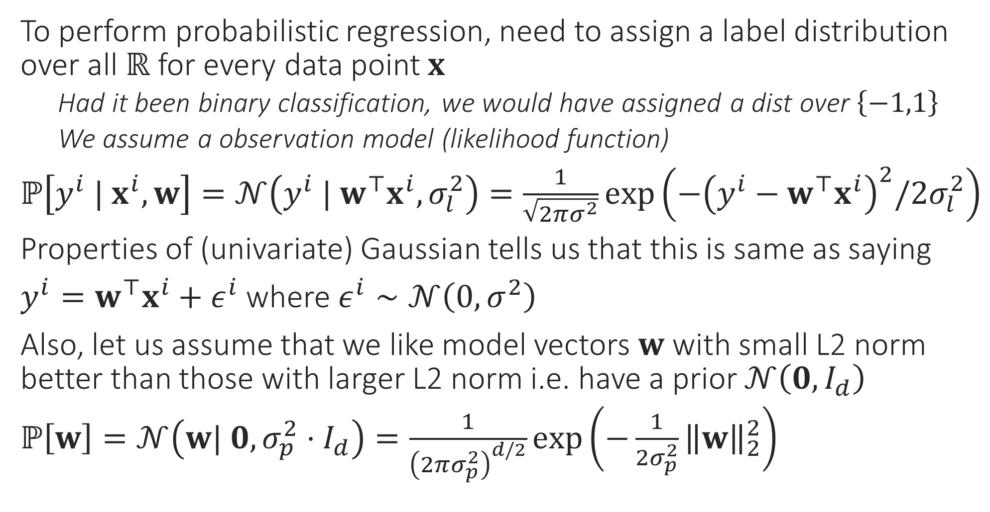
Probabilistic Regression Revisited
To perform probabilistic regression, need to assign a label distribution over all $ℝ$ for every data point $x$
Had it been binary classification, we would have assigned a dist over $\left\{−1,1\right\}$
We assume a observation model (likelihood function)
$ℙ\left[y^{i} | x^{i},w\right]=𝒩\left(y^{i} | w^{⊤}x^{i},σ_{l}^{2}\right)=\frac{1}{\sqrt{2πσ^{2}}}\exp\left(−{\left(y^{i}−w^{⊤}x^{i}\right)}^{2}/{2σ}_{l}^{2}\right)$
Properties of (univariate) Gaussian tells us that this is same as saying
$y^{i}=w^{⊤}x^{i}+ε^{i}$ where $ε^{i}∼𝒩\left(0,σ^{2}\right)$
Also, let us assume that we like model vectors $w$ with small L2 norm better than those with larger L2 norm i.e. have a prior $𝒩\left(0,I_{d}\right)$
$ℙ\left[w\right]=𝒩\left(w| 0,σ_{p}^{2}⋅I_{d}\right)=\frac{1}{{\left(2πσ_{p}^{2}\right)}^{d/2}}\exp\left(−\frac{1}{2σ_{p}^{2}}{\left\|w\right\|}_{2}^{2}\right)$

Slide 29


Probabilistic Regression Revisited
You might be wondering why conditioned as $ℙ\left[y^{i} | x^{i},w\right]$ and not $ℙ\left[y^{i},x^{i} | w\right]$. This is because we are currently assuming that features $x^{i}$ do not depend on the model $w$. Thus, the chain rule gives us $ℙ\left[y^{i},x^{i} | w\right]=ℙ\left[y^{i} | x^{i},w\right]⋅ℙ\left[x^{i} | w\right]$ and $ℙ\left[x^{i} | w\right]$ is just $ℙ\left[x^{i}\right]$ which does not depend on the model $w$. Note that we also assume in calculations that $y^{i},x^{i}$ are independent of $y^{j},x^{j}$ for $i≠j$
Recall that the prior encodes our beliefs before we have seen data
Posterior encodes our beliefs after we have seen data – Bayes Rule
$ℙ\left[w | y^{1},…,y^{n},x^{1},…,x^{n}\right]=$ $\frac{ℙ\left[y^{1},…,y^{n} | x^{1},…,x^{n},w\right]⋅ℙ\left[w\right]}{ℙ\left[y^{1},…,y^{n},x^{1},…,x^{n}\right]}$
Using independence gives us $=\frac{ℙ\left[w\right]⋅\prod_{i=1}^{n}{ℙ\left[y^{i} | x^{i},w\right]}}{\prod_{i=1}^{n}{ℙ\left[y^{i}, x^{i}\right]}}$
Ignoring terms that don’t involve $w$, taking logs gives us MAP estimate
${\hat{w}}_{MAP}=\arg{\min_{w∈ℝ^{d}}{−\ln{ℙ\left[w\right]}−\sum_{i=1}^{n}{\ln{ℙ\left[y^{i} | x^{i},w\right]}}}}$
Note: Likelihood is a distribution over labels i.e. over $ℝ$ but the prior and posterior are distributions over models i.e. over $ℝ^{d}$
We will soon study “generative” models where the features $x^{i}$ themselves would become random variables dependent on a (more complicated) model

Slide 30


MAP for Probabilistic Regression
Just so that we are clear, nothing special about $𝒩\left(w| 0,σ_{p}^{2}⋅I_{d}\right)$. If we believe $w$ is close to a vector $v$, should use $𝒩\left(w| v,σ_{p}^{2}⋅I_{d}\right)$ instead. MAP will become
$${\hat{w}}_{MAP}=\arg{\min_{w∈ℝ^{d}}{\frac{1}{σ_{p}^{2}}}{\left\|w−v\right\|}_{2}^{2}+\frac{1}{σ_{l}^{2}}\sum_{i=1}^{n}{{\left(y^{i}−w^{⊤}x^{i}\right)}^{2}}}$$
For Gaussian likelihood $𝒩\left(y^{i} | w^{⊤}x^{i},σ_{l}^{2}\right)$ and Gaussian prior $𝒩\left(w| 0,σ_{p}^{2}⋅I_{d}\right)$ we get ${\hat{w}}_{MAP}=\arg{\min_{w∈ℝ^{d}}{\frac{1}{σ_{p}^{2}}}{\left\|w\right\|}_{2}^{2}+\frac{1}{σ_{l}^{2}}\sum_{i=1}^{n}{{\left(y^{i}−w^{⊤}x^{i}\right)}^{2}}}$
Be careful, there are two variance terms here $σ_{l},σ_{p}$
The above is $\arg{\min_{w∈ℝ^{d}}{{\left(\frac{σ_{l}}{σ_{p}}\right)}^{2}⋅}{\left\|w\right\|}_{2}^{2}+\sum_{i=1}^{n}{{\left(y^{i}−w^{⊤}x^{i}\right)}^{2}}}$ i.e. ridge regression
Thus, $σ_{l},σ_{p}$ together decide the regularization constant
There is a multivariate version of the Laplace distribution too!
Using it as a prior with $μ=0$ (the zero vector) will give us LASSO!
Warning: expression for the Laplace PDF for general covariance is a bit tricky) $ℒ\left(w | μ,σ\right)=\frac{1}{{\left(2σ\right)}^{d}}\exp\left(−\frac{{\left\|w−μ\right\|}_{1}}{σ}\right)$

Slide 31
Bayesian Learning
Before we started doing probabilistic ML, we used to output a single label. With PML we started giving a distribution over labels instead
However, we still do so using a single model
In MLE we use the model with highest likelihood function value to do so
In MAP we use the mode of the posterior distribution to do so
In Bayesian learning, we take this philosophy further – instead of trusting a single model, we place partial trust, possibly over all models
Models with high posterior probability (density) value get high trust
Models with low posterior probability (density) value get low trust
We use Bayes rule yet again to perform these calculations

Slide 32

From PML to BML
I have with me data points $\left(x^{i},y^{i}\right)$, and a prior over models $ℙ\left[w\right]$
For a test point $x^{t}$, I wish to output a distribution over set of all labels i.e. $ℙ\left[y | x^{t},\left\{x^{i},y^{i}\right\}\right]$ – we condition on available data and $x^{t}$ as we know these
Since we need models to predict labels, let us introduce them
$ℙ\left[y | x^{t},\left\{x^{i},y^{i}\right\}\right]=\int_{ℝ^{d}}{ℙ\left[y,w | x^{t},\left\{x^{i},y^{i}\right\}\right]} dw$
$=\int_{ℝ^{d}}{ℙ\left[y | w, x^{t},\left\{x^{i},y^{i}\right\}\right]⋅}ℙ\left[w | x^{t},\left\{x^{i},y^{i}\right\}\right] dw$
$=\int_{ℝ^{d}}{ℙ\left[y | w, x^{t}\right]⋅}ℙ\left[w | \left\{x^{i},y^{i}\right\}\right] dw$
Step 1 (law of total probability) Step 2(chain rule of probability), Step 3(get rid of conditionings that did not matter)
Note: $ℙ\left[y | w, x^{t}\right]$ is the distribution we would have given had $w$ indeed been the true model and $ℙ\left[w | \left\{x^{i},y^{i}\right\}\right]$ is our faith in $w$ being the true model!

Slide 33

BML Trivia
$ℙ\left[y | x^{t},\left\{x^{i},y^{i}\right\}\right]$ is called the predictive posterior
Note: predictive posterior is a distribution over labels (not models)
For some very well behaved cases, the posterior and the predictive posterior distributions have closed form expressions
The special cases where we have something called conjugate priors are one such example
In all the other cases, we must use other techniques to work with the (predictive) posteriors in an approximate manner
Powerful sampling algorithms e.g. MCMC, Gibbs etc exist
Discussion beyond the scope of CS771 – courses like CS772 discuss this

Slide 34

Bayesian Regression
Suppose we have Gaussian likelihood $𝒩\left(y^{i} | w^{⊤}x^{i},σ_{l}^{2}\right)$ and Gaussian prior $𝒩\left(w| 0,σ_{p}^{2}⋅I_{d}\right)$, then we have $ℙ\left[w | \left\{x^{i},y^{i}\right\}\right]=𝒩\left(w;\hat{μ},\hat{Σ}\right)$
$\hat{μ}={\left(X^{⊤}X+{\left(\frac{σ_{l}}{σ_{p}}\right)}^{2}⋅I_{d}\right)}^{−1}⋅X^{⊤}y$ and $\hat{Σ}=\frac{1}{σ_{p}^{2}}{\left(X^{⊤}X+{\left(\frac{σ_{l}}{σ_{p}}\right)}^{2}⋅I_{d}\right)}^{−1}$
Note that the $\hat{μ}$ is simply the MAP solution – makes sense since MAP is the mode of the posterior and for Gaussian, mean is mode
Predictive Posterior: $ℙ\left[y | x,\left\{\left\{x^{i},y^{i}\right\}\right\}\right]=𝒩\left(y;{\hat{μ}}_{x},{\hat{σ}}_{x}^{2}\right)$ where
${\hat{μ}}_{x}={\hat{μ}}^{⊤}x$ and ${\hat{σ}}_{x}^{2}=σ_{l}^{2}+x^{⊤}\hat{Σ}x$
Note: in this case, variance of the predicted distribution ${\hat{σ}}_{x}^{2}$ depends on the point itself – can deduce if the prediction is confident or not!

Slide 35
Conjugate Priors
Bayesian Logistic Regression or Softmax Regression is not nearly as pretty – no closed form solutions for posterior or predictive posterior
However, some likelihood-prior pairs are special
Always yield a posterior that is of the same family as the prior
Such pairs of distributions are called conjugate pairs
The prior in such cases is said to be conjugate to the likelihood
Gaussian-Gaussian is one example – warning: one Gaussian is a likelihood over reals, the other Gaussian is a prior over models (i.e. vectors)
Other conjugate pairs exist too
Discussion beyond the scope of CS771 – courses like CS772 discuss this

